Slide 1
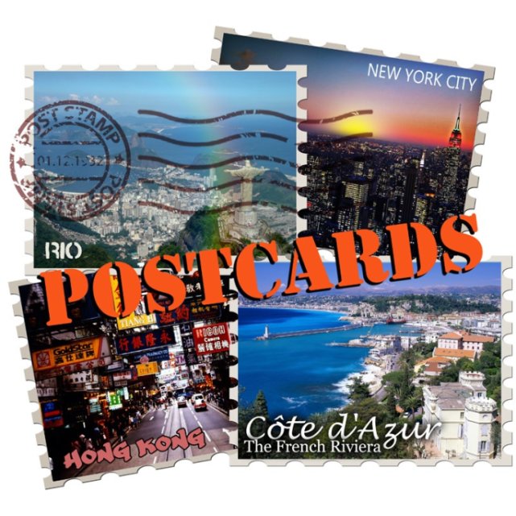
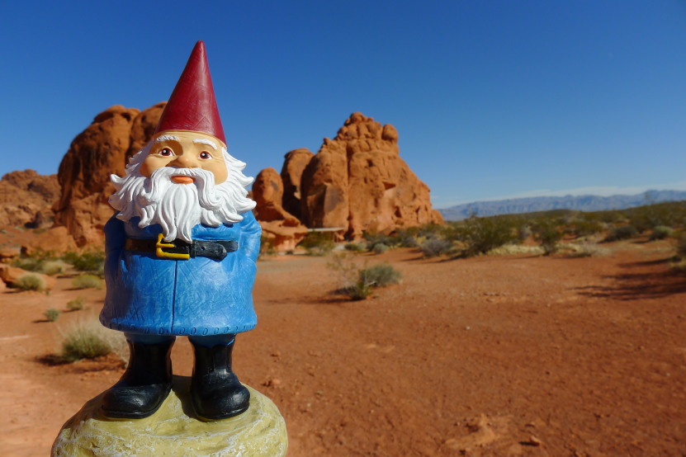
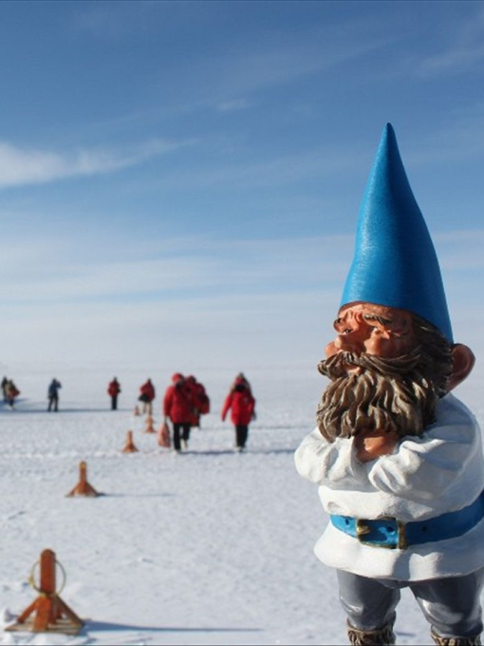
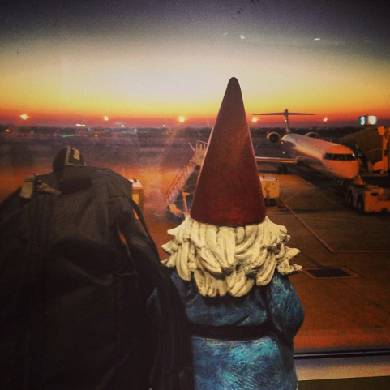
Globetrotter

Slide 2
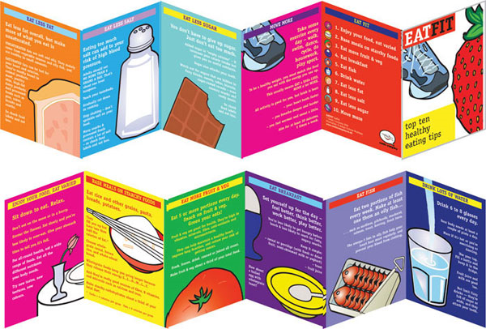
Learning Aims:
-I will be able to use my skills of analysis to compare and contrast two different sources.
-I will be able to discuss my findings with the class.
-I will create an informative leaflet on a destination of my choice.

Slide 3
The Cheesy/Inspirational Bit
“What inspires travel is the desire to be changed — to go, engage in a place, assimilate into its rhythms and quirks, and return home with its fragrant intoxication still swirling around in the brain. Travel is not tourism. It is not an appetite to be satiated. It’s not entertainment. Rather, it’s the intentional act of placing yourself in this location, with these people, in this landscape, with the hope that by being here and doing this you will somehow walk away a different person from when you walked in. It is by participating, not observing, that adventures build roots.”
www.gearpatrol.com
https://www.youtube.com/watch?v=wJF5NXygL4k
https://www.youtube.com/watch?v=UGnrT0F-Igs

Slide 4
If you could go on holiday anywhere in the world where would it be?

Slide 5
There are lots of different sources where you can find information

Slide 6
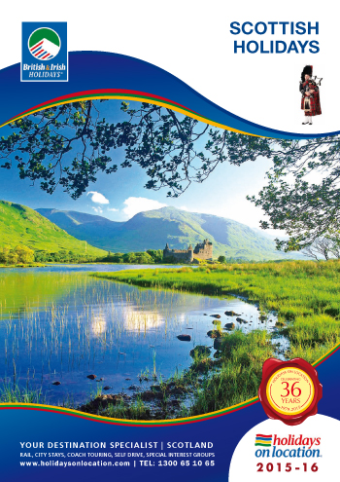
1.
What is the purpose of this text?
What would you expect to see lots of inside?

Slide 7
c) Write down the words the writer of the brochure has used in order to encourage us to visit. d) What other techniques has the writer used?
Extract: “Experience a region steeped in legend, folklore and history. The serene snow-capped peaks, glimmering lochs and sheltered forests of Loch Lomond, The Trossachs, Stirling & Forth Valley have inspired great heroes and artists alike. Today, find magnificent food and drink, animated city life and bustling creative towns and villages nestled alongside the tranquil setting of Scotland’s first National Park”

Slide 8
a) Where has this source been found? b) What is the purpose of this text?
2.

Slide 9
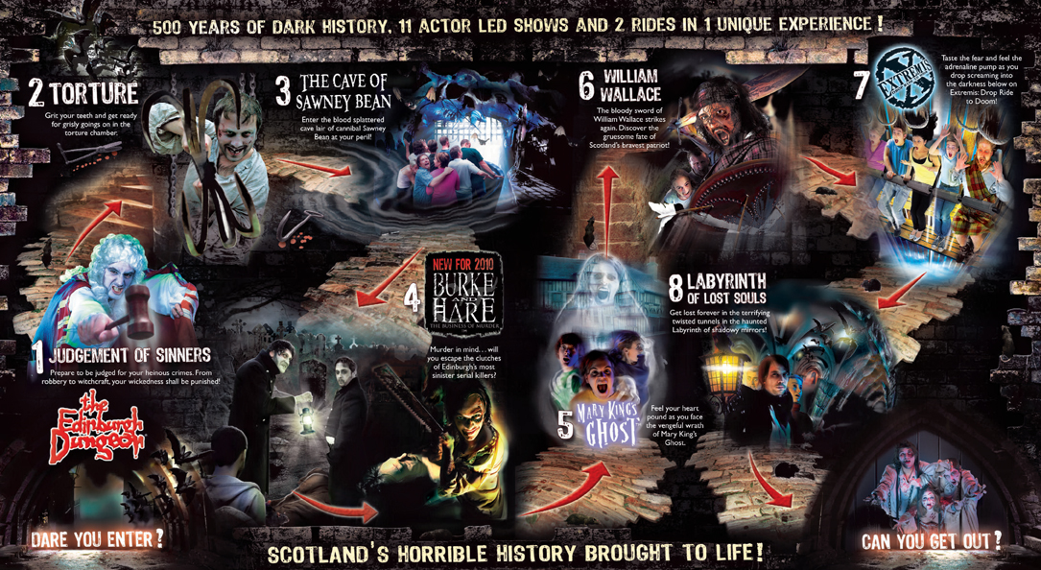
3.
What kind of text is this?
What is the purpose of this text?
Who do you think this is aimed at and why?
How have they tried to make the layout clearer?

Slide 10
4.
How do you know this source is taken from a newspaper? Comment on at least 3 things.
What is the purpose of this text?
What have they included in order to make the story clearer?

Slide 11
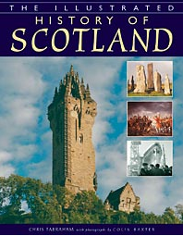
5.
6.
What is the purpose of both these texts?
Who do you think 5 is aimed at and why?
Who do you think 6 is aimed at and why?

Slide 12
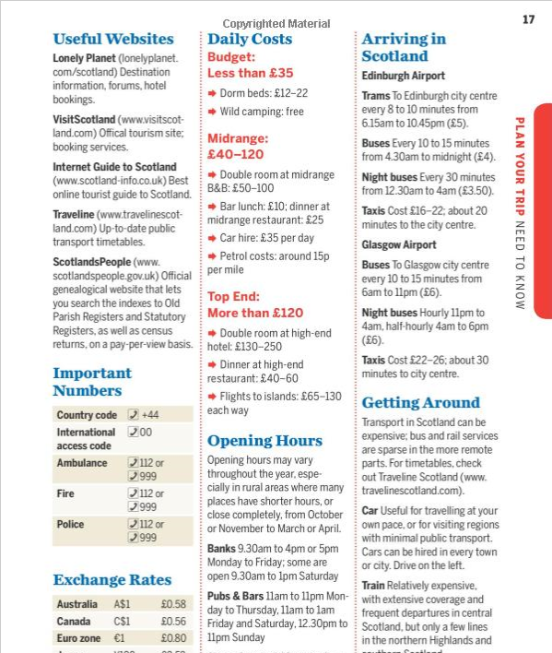
7.
a) What kind of text is this? b) What is the purpose of this text? c) Who do you think this is aimed at and why?

Slide 13
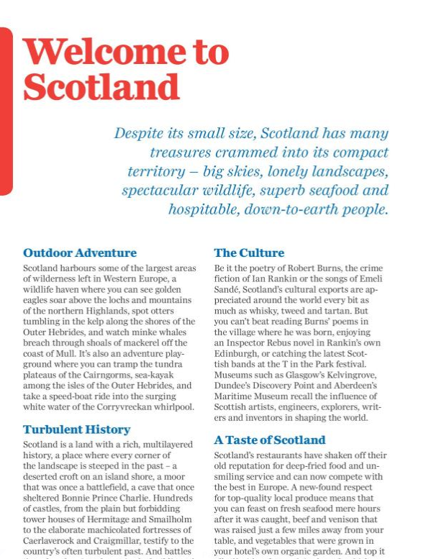
d) Here’s a page taken from the Lonely Planet Scotland guide. How do we know it is not aimed at children? Comment on layout and language.

Slide 14
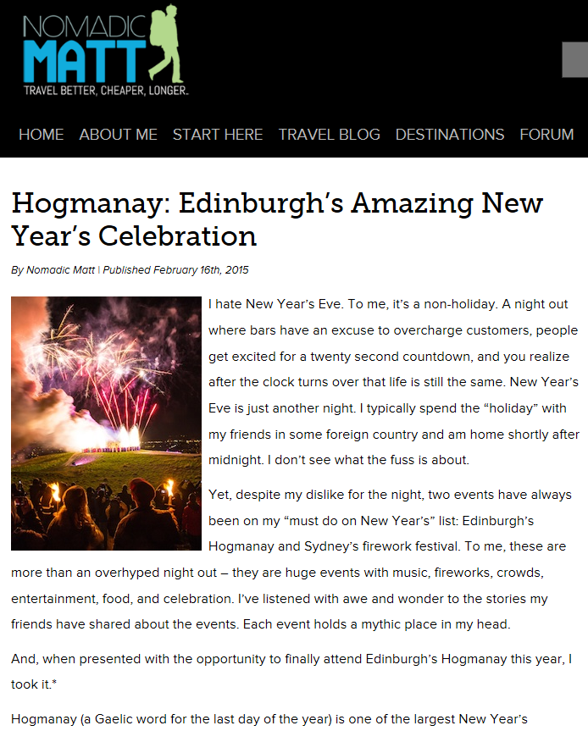
8.
What kind of text is this?
Would you expect language to be formal or informal?
Who do you think this is aimed at and why?
http://www.nomadicmatt.com/travel-blogs/hogmanay-edinburgh/

Slide 15
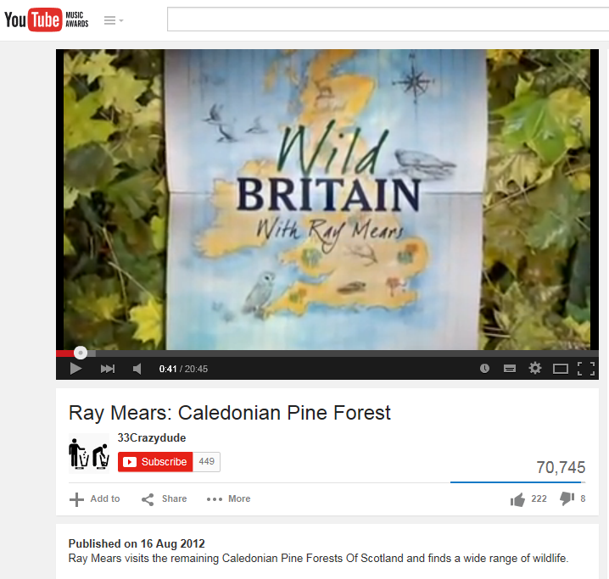
9.
https://www.youtube.com/watch?v=cy2CfNI-mS4&feature=youtu.be

Slide 16
a) Who would be likely to watch/listen to this television programme
You may consider:
Age
Interests
Gender
Nationality
Class
Another Audience You Have Identified
b) Explain how you reached this conclusion.
c) Do you think the purpose of the extract is to: inform and/or persuade and/or entertain? Explain your reasons for thinking this.
d) Summarise four key points that you learn about this area of Scotland.

Slide 17
10.
https://www.youtube.com/watch?v=2HuTYYg36V0

Slide 18
a) Who would be likely to watch/listen to this television programme
You may consider:
Age
Interests
Gender
Nationality
Class
Another Audience You Have Identified
b) Explain how you reached this conclusion.
c) Do you think the purpose of the extract is to: inform and/or persuade and/or entertain? Explain your reasons for thinking this.

