Slide 1
Mobile Phones and Learning

Slide 2
Benefits of a Mobile Phone
We love our mobile phones! There are so many GREAT things about them:-
Quick to communicate
Social groups (Zoom, Facetime, Facebook etc)
Internet access for information/research
Online shopping/bookings
Multifunctional apps

Slide 3
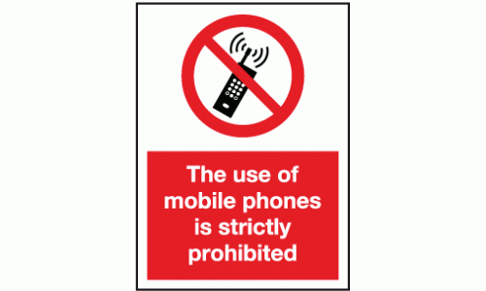
Mobiles phones in School
Mobiles phones can be great to use in school too! Some benefits include:-
Storing reminders or home learning in a diary/notes.
Having access to Teams to communicate with your teacher/class.
Using your phone for research purposes to encourage independent learning.
Recording performances/interview for evaluation purposes.

Slide 4
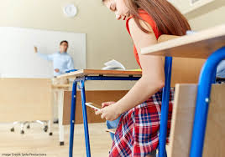
Mobile phones in THE CLASSROOM
HOWEVER……..
Many teachers have fed back that when pupils access their mobile phones during a lesson they can often lose focus and go off task.
Pupils who use their mobile phones in class often miss instructions and are not then able to carry out tasks alongside the class.
Instructing pupils to put away mobile phones disrupts the teaching and learning of the other pupils and slows down the lesson, resulting in less learning for all.

Slide 5
If your teacher allows you for learning purposes, your mobile can still be a great tool to use… but only if used appropriately.

Slide 6
INAPPROPRIATE USE OF PHONES
To ensure teaching and learning can occur, teachers will now alert the pupil’s parents/cares on a period by period basis if a mobile phone is used inappropriately in class without permission from the teacher.
1st USE OF PHONE (without permission)
Pupils will be asked to put away their phone by the class teacher and reminded a text message will be sent home if further use.
2nd USE OF PHONE (without permission)
Class teacher will trigger a text message home to parents/carers.
‘NAME’s use of their mobile phone was disrupting teaching and learning in SUBJECT on DATE.’
3rd USE OF PHONE (without permission)
The teacher will put in a referral to the Curriculum Leader for further communication with parents/carers and House Head if necessary

Slide 7
Leith LOVES LEARNING
We are so happy to have the pupils and staff in the school building again and we are very much looking forward to teaching, learning and socially interacting in the classroom! So when in class pop your phone in your bag unless given permission to use by your class teacher.

