Slide 1
Men's mental health – man alive
Key adult 15th october

Slide 2
man alive
Man Alive is a men's mental health group at Leith Academy.
Man Alive is a platform for young men to speak openly and confidently about any mental health issues they are facing.
We aim to give the young people of Leith Academy a safe space to receive support whenever they need it.
Why is this important to us? The next slide provides some stats that we think demonstrate the importance of the project...

Slide 3
Stats – why is men's mental health important?
In 2009, MIND commissioned YouGov to conduct a survey (over 2,000 responses) on men and women's coping mechanisms and help-seeking behaviours.
37% of men admitted to regularly feeling worried or feeling low at the time of the survey.
Men were half as likely as women to go to a counsellor or thearpist to talk about their feelings.
Young men were the most likely group to tell a friend to 'pull themselves together' when feeling down or depressed.
Men account for 78% of suicides in the UK (ONS, 2013)

Slide 4
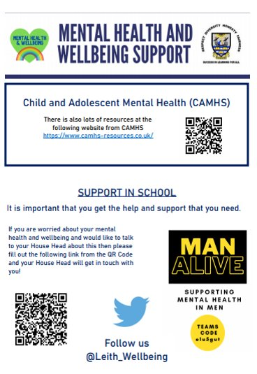
Where can I get support in the school?
Man Alive Club – Every Wednesday after school; you can drop into the Clubhouse to play pool, darts and/or PS4 games.
Nurture Base
The Centre
Key Adult

Slide 5
Where can I get support in the school?
Speak to staff – a list of staff you could speak to via the self-referral form:
Mr Ferns
Mr Hodgson
Mr Stewart
Mr McCurdy
Mr Irvine
Craig Maughan
Mr Connor

Slide 6
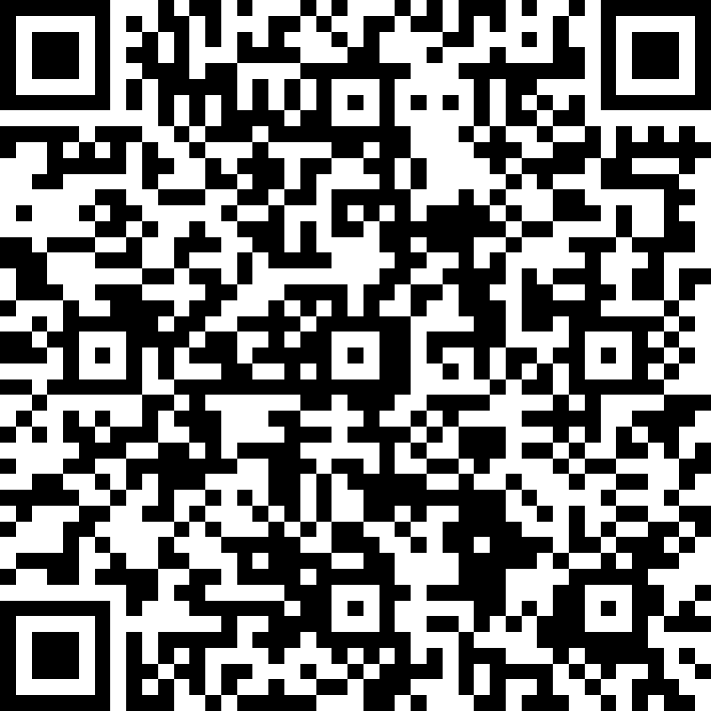
Self-referral form
A QR code is attached to this slide – takes you to a Forms page. This allows pupils to reach out for support without approaching a member of staff.
The Man Alive team will sort a time and space for any pupil who self-refers, to meet with a supporter.
Man Alive Post-Box - outside the PE changing rooms for self-referral sheets.

Slide 7
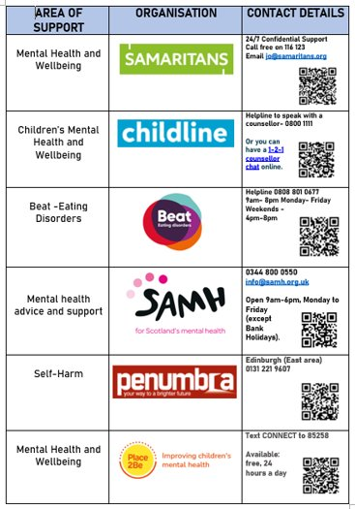
Where can I get support outwith school?
Any of the following organizations on the right hand side.
The Junction
Pilton Community Health Project
The Men of Leith Men’s Shed.

Slide 8
Movember – what is it?
Movember is a charity which looks at raising awareness and supporting men's health, targeting Mental Health and Suicide prevention, prostate cancer and testicular cancer.
Staff at Leith Academy are already supporting Movember by growing a moustache throughout the full month of November to help raise awareness of Men’s Mental Health.
Support this by growing a moustache throughout the month of Movember and donate to the Movember website. Thanks!

Slide 9
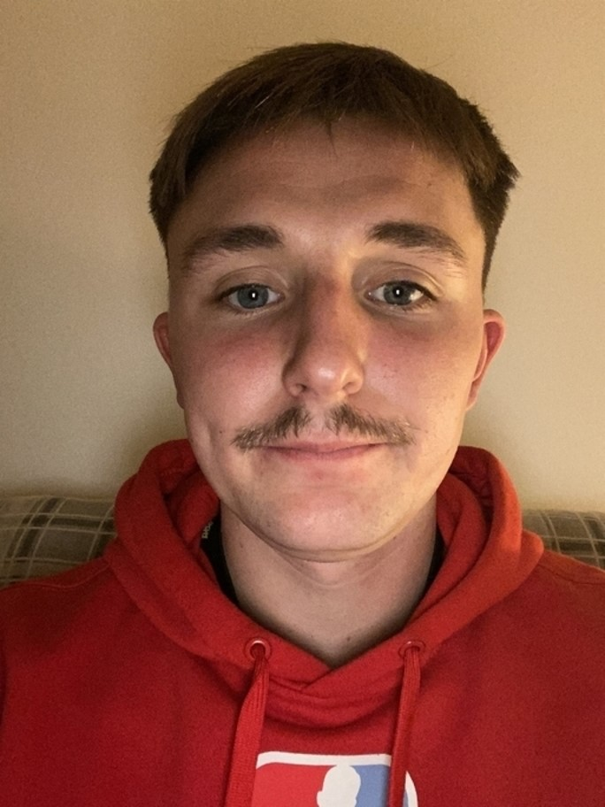
Mr Ferns’ Movember
Here is a photo of Mr Ferns’ attempt last year; remember not everyone is able to grow a full moustache so don't be afraid to join our movement!
Mr Ferns’ Movember from November 2020
Can you beat this??

