Slide 1
Three weeks today we break up for the Christmas holidays!

Slide 2
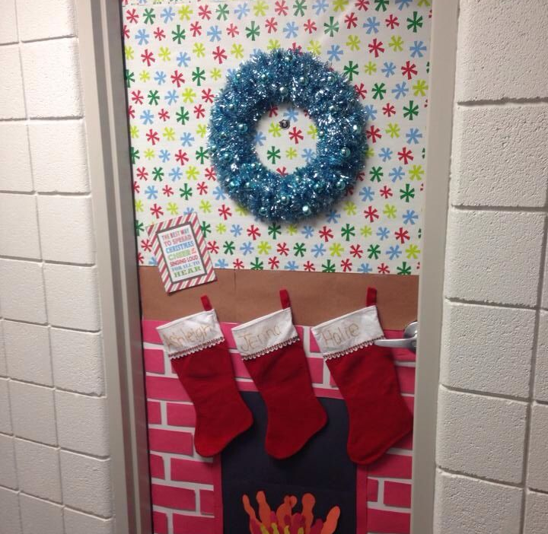
Let's begin to get festive with a Christmas Decorating Competition in KAG

Slide 3
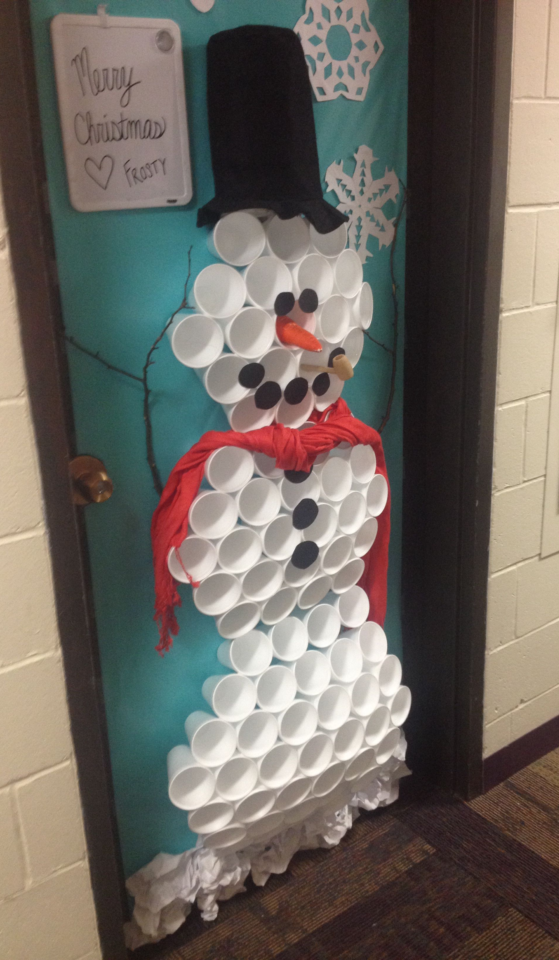
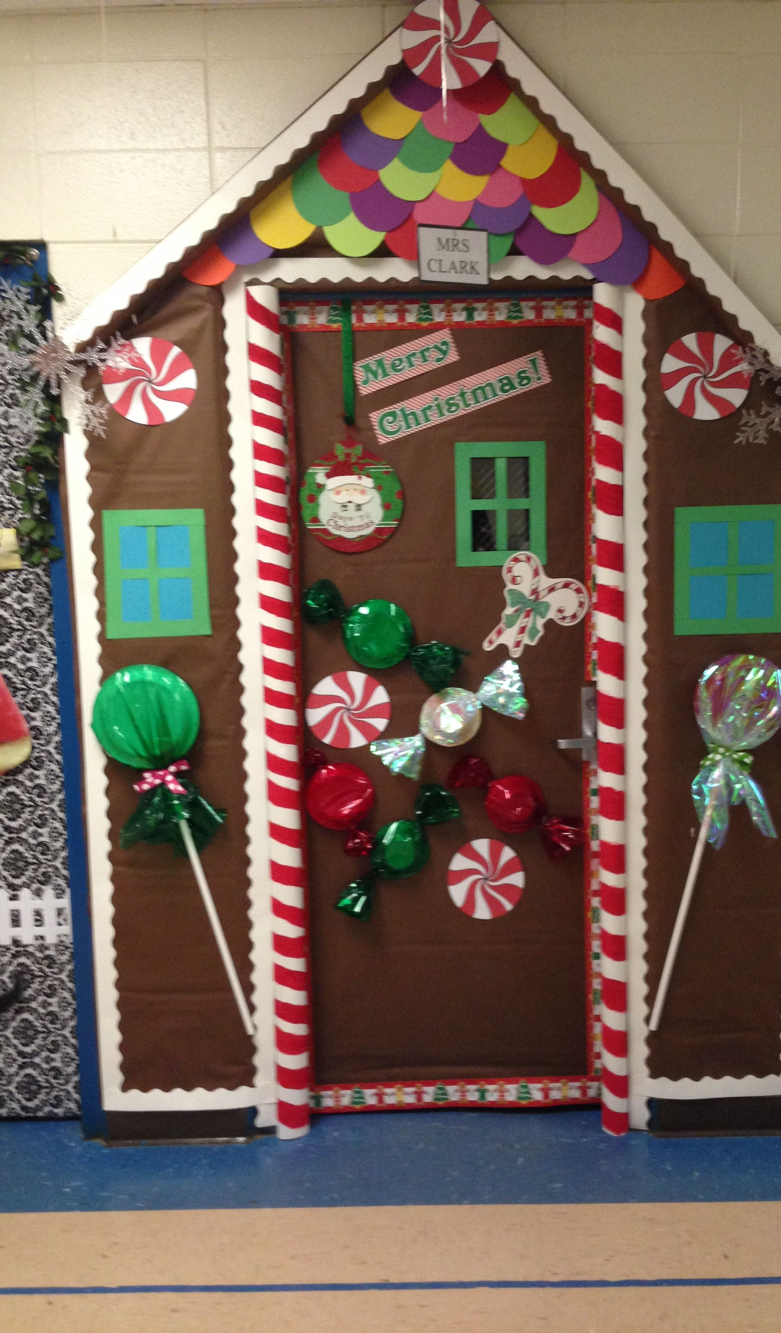
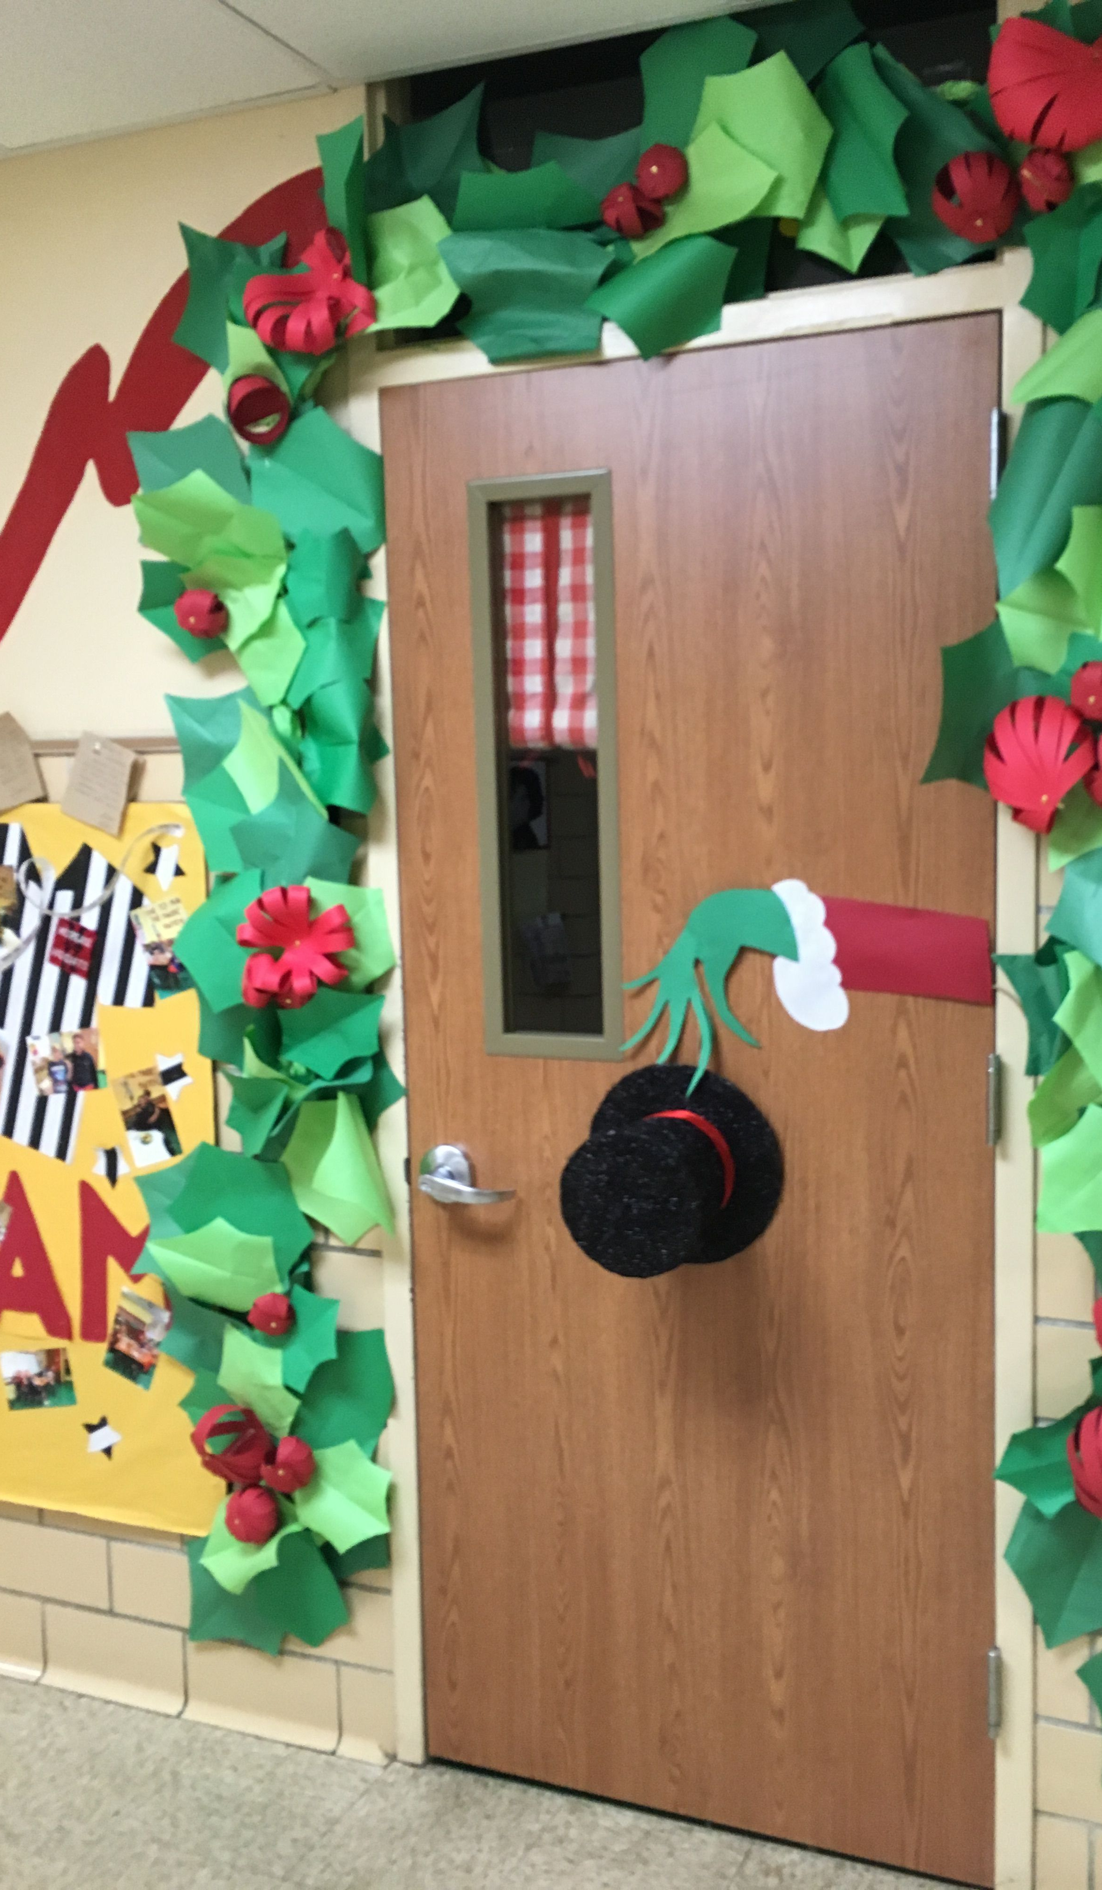
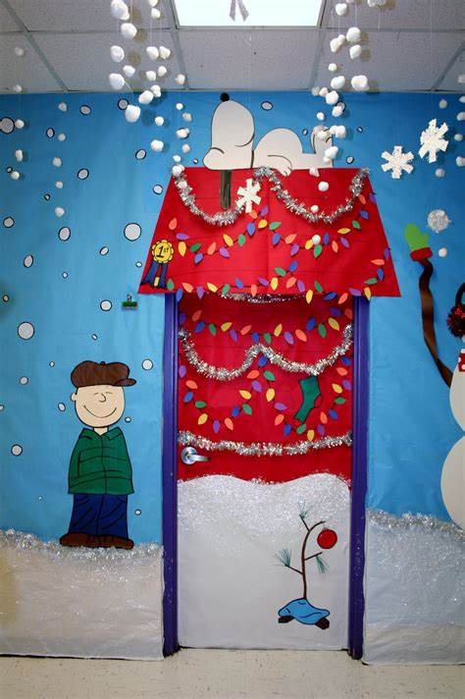

Slide 4
Criteria
Decorate the door and /or your Key Adult classroom.
Be creative with the materials you use. Recycle/reuse where you can.
Do not create a fire hazard!!!!
Make sure it is finished by Friday 10th December; judging will take place the following week.

Slide 5
Michael Buble - It's Beginning to Look a Lot Like Christmas (lyrics) - YouTube

