Slide 1
SCHOOL RESOURCES
A guide for Leith Academy’s LGBT+ Youth

Slide 2
1. Gender Neutral Bathroom
And where to find it!
Our school’s gender neutral bathroom is located to the left of the staffroom. Please be mindful that it can be quite busy at times!
Go through the door near Miss Watson’s office (near the front office).
Walk all the way down to the first left.
Turn left.
The bathroom is the one with a sliding door.

Slide 3
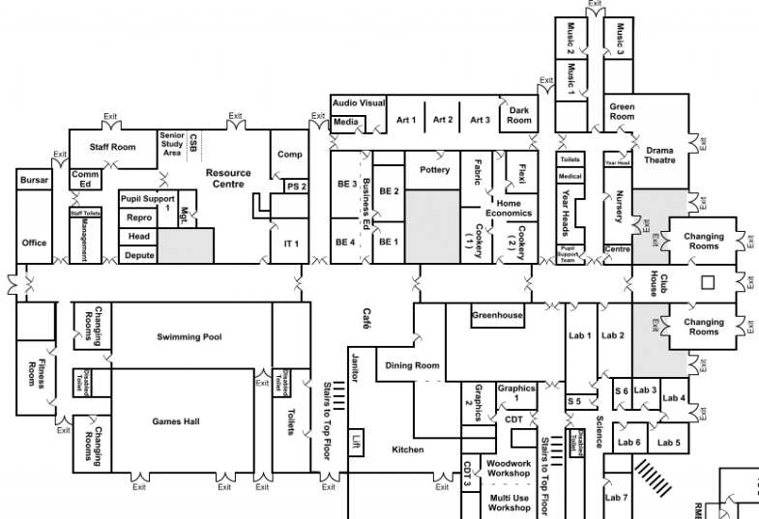

Slide 4
2. Helpful Resources
There are many posters around the school with various mental health resources.
There is also a variety of leaflets at the bottom of the Art department with help on coming out etc.

Slide 5
3. Anonymous Suggestion Box
Because everyone can make a difference
At Mr. Connor’s office there is an anonymous suggestion box in the form of an envelope on his door.
Please feel free to drop in any suggestions or concerns you have! Everybody is welcome to do so and vital to help improve our school.

Slide 6
What Should I Do if I witness Homo/transphobia?
I Witness homophobia or transphobia
Is it safe to step in?
yes
no
Step in, as quickly as possible
Is someone in immediate danger?
Comfort victim
yes
no
Report incident
Find nearest adult who can help
Wait to help the victim
Report incident
Find adult. Report incident

Slide 7
4. People to Turn to
We’re all here to help!
There are many people who can help in our school:
Mr Irving, Mr Stewart, Mrs Fair and Miss Watson
House Heads
Any member of staff
Mental Health clubs (e.g. Man Alive)
Spectrum
Our Prefects and Equalities Ambassadors

Slide 8
5. Spectrum!
( us ☺ )
Spectrum is Leith Academy’s LGBT+ Club
We welcome everyone!
There are posters with information around the school.
You can contact Mr Stewart or Mr Connor if you want to join our TEAMS page.
We meet on a Monday at lunch in the Drama Studio.

Slide 9
Thanks!

