Slide 1
S4,5,6 How to Pass your Qualifications

Slide 2
Welcome
Thank you for coming along.
Learning Intention:
To help you support your child through their National Qualifications
To allow us to work together as a School and Home / Family
To help develop your understanding of the Scottish system (SQA)

Slide 3
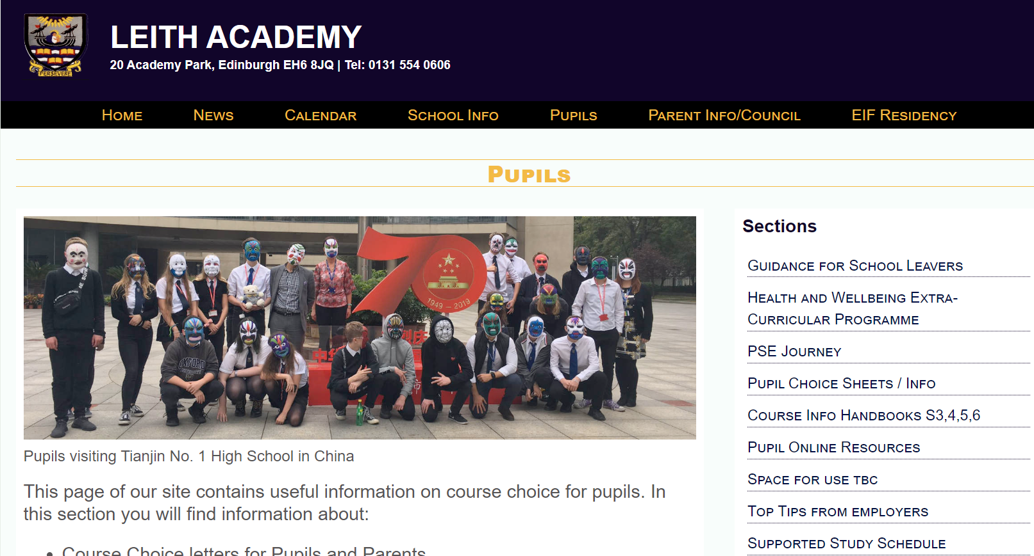
Keep updated
@leithacademy
https://leithacademy.uk
CALENDAR WITH DATES

Slide 4
Our Values….Day in day out
-LGBT+
-Equalities and Inclusion
-Sustainability
-Health & Wellbeing
-Restorative
-Curriculum Pathways
-Key Adult
-Sticking with it
-Resilience
-Growth mindset
SQA
Positive Destinations
Wider Achievement

Slide 5
PROCESSES AND GOOD HABITS ARE VITAL!

Slide 6
Our youngsters do well!
LEARNERS LEAVE LEITH ACADEMY WITH POSITIVE LIT / NUM OUTCOMES

Slide 7
Our latest S4,5,6 Leavers
YOUNGSTERS LEAVE US ONTO THEIR NEXT DESTINATION….WITH POSITIVE OUTCOMES

Slide 8
The link is crucial!
HOME
SUCCESS IN LEARNING FOR ALL
SCHOOL
LEARNER

Slide 9
Signposting is the aim
We want to help you, help your children
Provide quick, easy, simple links to support
Keep communication open throughout the year to help supportive conversations = improved outcomes

Slide 10
Our Focus
Results and Achievements are key areas of focus for us
- improved outcomes to help young people in their next step
Literacy and Numeracy are key areas of focus
- improved outcomes increase life chances / opportunities for all
Having a path into a Positive Destination is a key focus
Being aspirational in all that we do

Slide 11
Scottish Qualification Authority SQA
National 1,2,3,4
Some internal units (2 or 3) to help assess learning
Internal Added Value Unit
Some work marked by Leith Academy staff: folios, practical work, performances, portfolios
No final exam required: pass or fail

Slide 12
Scottish Qualification Authority SQA
National 5 / Higher / Advanced Higher
Some work marked by Leith Academy staff: folios, practical work, performances, portfolios
Some work sent to SQA to be marked: folios, dissertations, art work
An exam, in most subjects
Level 5 and 6 NPAs
No exam, all work is made up of units to be marked: folios, practical work, performances, portfolios

Slide 13
Prelims - Some points of interest
Monitoring and Tracking 1st report - Friday
Online Parents’ Evenings coming up – progress check, target setting
(1st November Anderson/Barton and 16th November Cowan/Port)
Prelims – 27th November (5 weeks after October break)
Prelims are not there to catch youngsters out
Prelims should allow Pupils to know strengths…and areas to improve
SQA 2024 Exam timetable – highlight your exams!

Slide 14
Live N Learn Wed 1st November
Session for all S4 Pupils around mindset, aspiration, being positive, study techniques

Slide 15
Microsoft Teams – materials, lessons, help

Slide 16
How to Pass Guides
Available to borrow
Sign-out from Mrs Boal (Learning Resource Centre)

Slide 17
Our key messages to Pupils
Plan your revision time, free time, family time
Ask questions! You need to be honest and open and ask us
Eat, drink, sleep - repeat
Attend supported study (and Easter Revision) sessions as required
Carefully consider the tracking reports…borderline band 7
The following have lots of resources and revision materials:
- Class Teams
- Scholar (see Miss Bell for login)
- E-sgoil (see Mrs Boal for Glow login)
- ClickView
- SQA website (past papers from previous years and Understanding Standards)

Slide 18
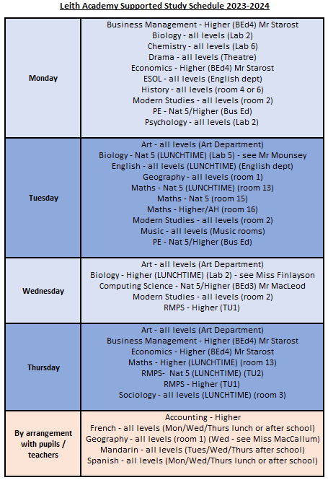

Slide 19
https://scholar.hw.ac.uk
Email or speak to Miss Bell if you don’t have your login details.

Slide 20
Webinars will start in the week beginning October 30th.

Slide 21
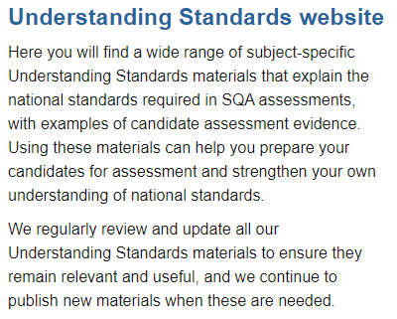
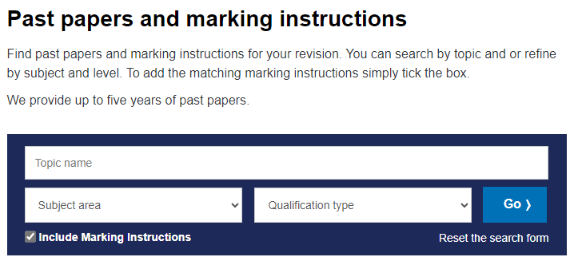
SQA Website
SQA - NQ - Past papers and marking instructions
SQA - Understanding Standards: About this website

Slide 22
Kate Watson
Pupils can make an appointment with Kate in the Learning Resource Centre

Slide 23
Make it visible…

Slide 24
It takes a village – Our Partners
We can’t achieve just as a School
We need Families, Partners, Communities

Slide 25
‘Break out’ opportunity
Move round the stalls
Speak to subject teachers and Prefects

