Slide 1
S4 Assembly
Senior Phase ‘push’

Slide 2
The year goes fast…
1 weeks today October half term
6 weeks we begin our S4,5,6 Assessment window 1
Learn from the advice, the reports, the feedback….take steps now!

Slide 3
Success in Learning for All

Slide 4
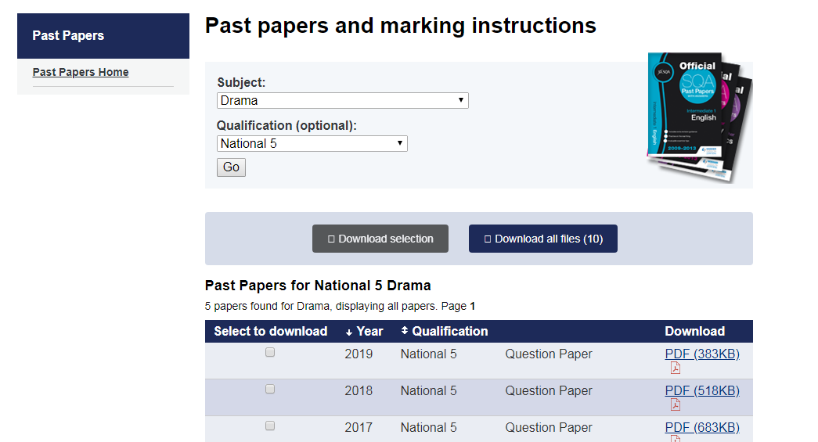
Get started

Slide 5
Live N Learn
We believe in you
We invest in you
We want you to feel supported

Slide 7
Holding doors open
Work placement
Start to think…what do I need?
Speak to us….we have contacts

Slide 8
Rethink your drink? HWB week
GIRLS IN SPORT TODAY ACROSS THE COUNTRY!
SESSIONS FOR ALL ALSO AVAILABLE

Slide 9
Finally….

Slide 10
Big 10 weeks coming up….get set

