Slide 1
S4,5,6 How to Pass your Qualifications

Slide 2
Welcome
Thank you for coming along.
Learning Intention:
To help you support your child through their National Qualifications
To allow us to work together as a School and Home / Family
To help develop your understanding of the Scottish system (SQA)

Slide 3
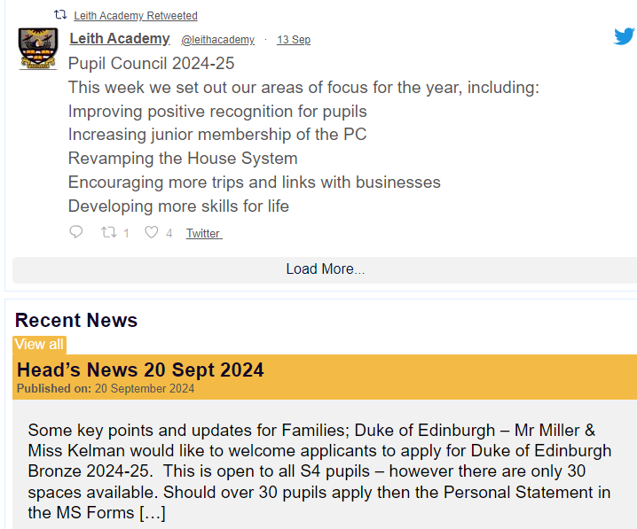
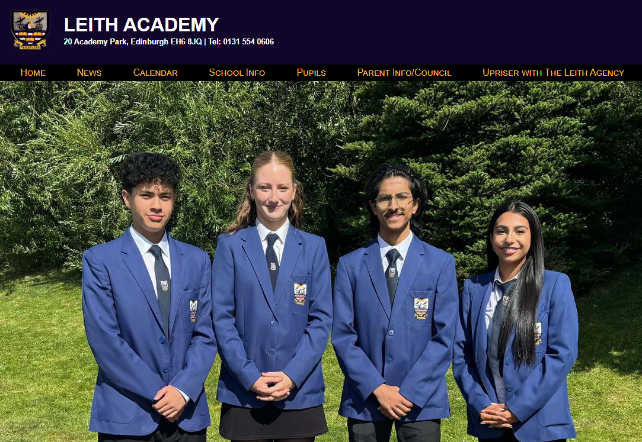
Keep updated
@leithacademy
https://leithacademy.uk
CALENDAR WITH DATES

Slide 4
Our Values….Day in day out
-LGBT+
-Equalities and Inclusion
-Sustainability
-Health & Wellbeing
-Restorative
-Curriculum Pathways
-Key Adult
-Sticking with it
-Resilience
-Growth mindset
SQA
Positive Destinations
Wider Achievement

Slide 5
PROCESSES AND GOOD HABITS ARE VITAL!

Slide 6
Our youngsters do well….deservedly
LEARNERS LEAVE LEITH ACADEMY WITH POSITIVE LIT / NUM OUTCOMES

Slide 7
The link is crucial!
HOME
SUCCESS IN LEARNING FOR ALL
SCHOOL
LEARNER

Slide 8
Signposting is the aim
We want to help you, help your children
Provide quick, easy, simple links to support
Keep communication open throughout the year to help supportive conversations = improved outcomes

Slide 9
Our Focus
Results and Achievements are key areas of focus for us
- improved outcomes to help young people in their next step
Literacy and Numeracy are key areas of focus
- improved outcomes increase life chances / opportunities for all
Having a path into a Positive Destination is a key focus
Being aspirational in all that we do

Slide 10
Scottish Qualification Authority SQA
National 1,2,3,4
Some internal units (2 or 3) to help assess learning
Internal Added Value Unit
Some work marked by Leith Academy staff: folios, practical work, performances, portfolios
No final exam required: pass or fail

Slide 11
Scottish Qualification Authority SQA
National 5 / Higher / Advanced Higher
Some work marked by Leith Academy staff: folios, practical work, performances, portfolios
Some work sent to SQA to be marked: folios, dissertations, art work
An exam, in most subjects
Level 5 and 6 NPAs, Skills for Work, Awards
No exam, all work is made up of units to be marked: folios, practical work, performances, portfolios

Slide 12
Key Dates
1st Tracking Report – week beginning 7th October
IN PERSON Parents’ Evenings coming up – progress check, target setting
(30th October Anderson/Barton and 12th November Cowan/Port)
Prelim Window 1 – Practical/classroom-based 2nd – 13th December
Prelim Window 2 – Games Hall 13th – 17th January
Prelims are not there to catch youngsters out
Prelims should allow Pupils to know strengths…and areas to improve
SQA 2025 Exam timetable – highlight your exams!
National Qualifications 2025 Exam Timetable (sqa.org.uk)

Slide 13
Live N Learn Session
Session for all S4 Pupils around mindset, aspiration, being positive, study techniques

Slide 14
How to Pass Guides
Available to borrow
Sign-out from Joe (Learning Resource Centre)

Slide 15
Microsoft Teams – materials, lessons, help

Slide 16
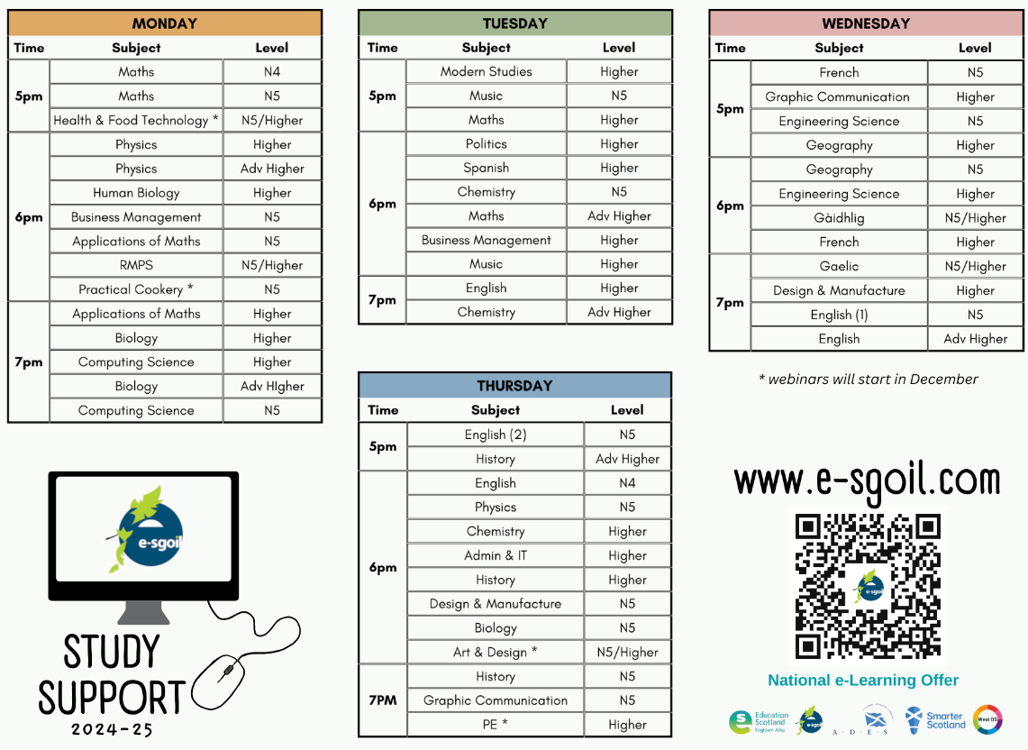
Webinars will start 28th October.

Slide 17
Our key messages to Pupils
Plan your revision time, free time, family time
Ask questions! You need to be honest and open and ask us
Eat, drink, sleep - repeat
Attend supported study (and Easter Revision) sessions as required
Carefully consider the tracking reports…borderline band 7
The following have lots of resources and revision materials:
- Class Teams
Scholar (see Miss Bell for login)
Achieve
- E-sgoil
- ClickView
- SQA website (past papers from previous years and Understanding Standards)

Slide 18
Websites to ENHANCE your learning
Scholar: pioneering education with Heriot Watt university since 1999, marry the best of education and technology to create an exceptional learning experience. Scholars content is crafted with practising subject-specialist teachers, ensuring its content is relevant and in-depth.
Achieve: is a website where you can learn, assets and self-evaluate. It provides necessary information about topics and subtopics within your chosen courses.
BBC Bite Size: can be used to help you with your homework or to help you revise your subjects with videos, notes, activities and quizzes.

Slide 19
https://scholar.hw.ac.uk
Email or speak to Miss Bell if you don’t have your login details.

Slide 20
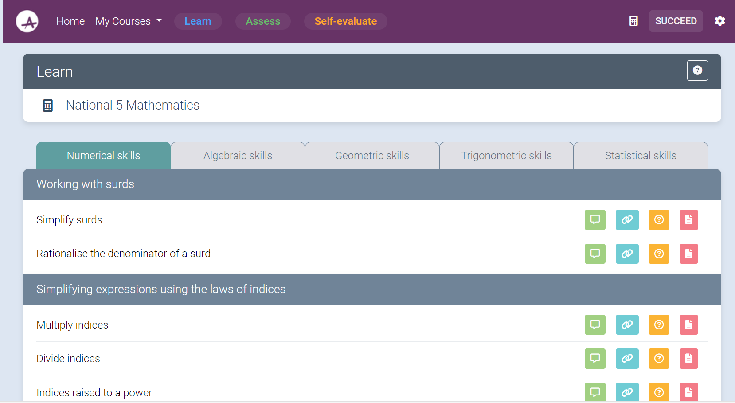
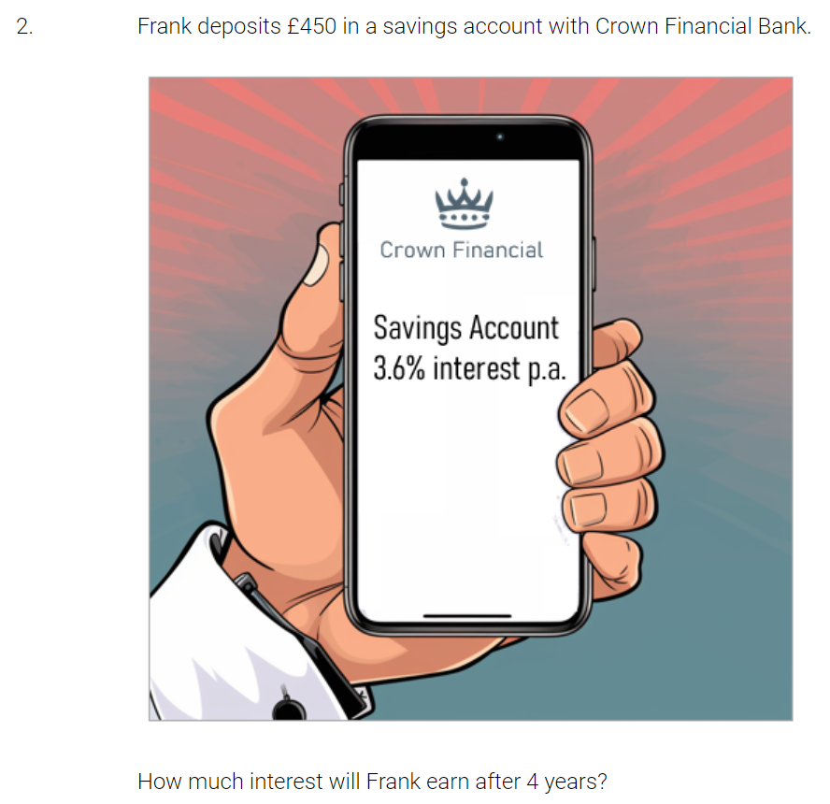
Ask your teacher for your login

Slide 21
USEFUL TOOLS FOR REVISION
TEAMS AND ONE NOTE

Slide 22
TEAMS
ONE NOTE
It is important to be on schedule for revision and coursework. Teams can be a useful resource to improve time management:
Be prepared. Make sure to check teams
Consistently, it is important to be aware
of updates and deadlines.
Every little Helps. Make most of the files section to access additional learning resources and coursework.
A useful tool to catch up on missed course content.
Some of the resources One Note offers:
Course notes and revision notes.
Past papers and worksheets
Track progress. Make personal sections and attempt past paper questions.
Get as much feedback as possible from teachers (on and off school) e.g. markings.

Slide 23
Past Papers
Ability to access past papers on some subjects back to 2018
Very useful in testing yourself and acknowledging what needs to be worked on
Marking instructions available to be able to recognise where marks were gained/lost
https://www.sqa.org.uk/pastpapers/findpastpaper.htm

Slide 24
Supported Studies
They are run by each department at lunchtime or after school
It’s not run like a lesson, it’s self-led
I would advise all year round, consistency is key
Perfect for subjects you find slightly more challenging
They allow you to have access to a teacher to ask questions to when confused
Great for motivation
Bring your friends along and help each other out.

Slide 25
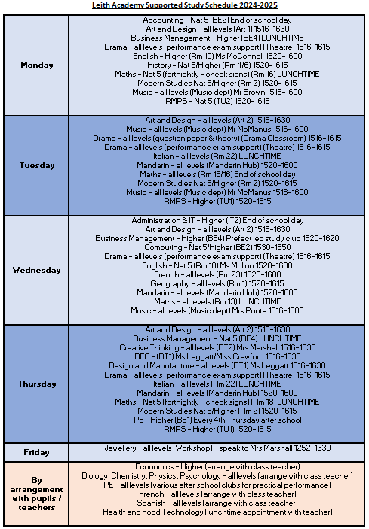

Slide 26
Choosing your revision method
Out of all of the revision methods we talked about before, at least one or two is bound to stick!
The best way to find out which revision method works for you is to revise using a method and then completing a past paper exam.
Depending on your result, you can then settle on the method.
Your revision method can change over time, so make sure to keep researching.

Slide 27
Make it visible…

Slide 28
It takes a village – Our Partners
We can’t achieve just as a School
We need Families, Partners, Communities
Pupils can make an appointment to see Giles, our Careers Advisor.

Slide 29
‘Break out’ opportunity
Move round the stalls
Speak to subject teachers and Prefects

