Slide 1
Learners’ Journeys
Curriculum for Excellence
Leith Academy

Slide 2
Motto, Vision and Values:
PERSEVERE
Success in Learning for All
Respect
Diversity
Honesty
Fairness

Slide 3
Qualifications
Standard Grade Higher Still National Qualifications
Foundation Access 3 National 3
General Intermediate 1 National 4
Credit Intermediate 2 National 5/NPA
Higher Higher Higher/NPA/FAs
CSYS Advanced H Advanced H

Slide 4
S3 – Continuing the Broad General Education
English
Maths
Modern Languages - French
Science – Biology/Chemistry/Physics/Triple Science*
Social Subjects – Geography, Mod Studs, History, ACHIEVE*, RMPS, World Studies plus Youth Philanthropy Initiative
Technologies – World of Computing and World of Business; Design Technology and Practical Skills; Health and Food Tech
Expressive Arts – including Football, HFT, Art, Drama, Music and Dance
Elective/Choice – with Mandarin, Spanish, Media, Music Technology and selected subjects from areas above
PE/RMPS/PSE

Slide 5
The Process:
Discussions with class teachers
Support from Skills Development Scotland – Giles Macnair
Support from House Heads, SfL and DHTs
S2 Parents’ Consultation – 16.1.25 – teacher input - ONLINE
Learner Pathway sheet completed and handed or emailed to the House Head; course selection checked and entered with pupil – from 20.1.25
Changes possible for some months after this
New timetable in June 2025

Slide 6
House Heads:
Anderson – Mr Fox: Daniel.Fox@leith.edin.sch.uk
Barton – Miss Lindsay: Laura.1.Lindsay@leith.edin.sch.uk
& Mrs Simpson: kelly.simpson@leith.edin.sch.uk
Cowan – Mrs O’Brien: Jenna.O’brien@leith.edin.sch.uk
Port – Mr Connor: Blair.Connor@leith.edin.sch.uk
Mr Stewart: Benjamin.Stewart@leith.edin.sch.uk

Slide 7
Where will you be and what will you be doing in 10 years’ time?

Slide 8
S4 – Beginning of Senior Phase
English/ESOL
Maths/Applications of Maths
7 Subjects in Total from 2026 onwards
J.E.T./ACHIEVE
2xPE (Performance Unit and others)
1xRMPS/PSE
S4-6 in National classes

Slide 9
Learner Pathways
Examples of possible routes through S3 and onwards…

Slide 10
Ayo
S3
English
Maths
French
Biology
Modern Studies
World of Business
PE
Mandarin
S4
English N5
Maths N5
Mandarin N5
French N5
Spanish N5
Business Man. N5
PE N5

Slide 11
Ayo
S5
English H
Maths H
Mandarin H
French H
Spanish H
S6
French AH
Spanish AH
English AH
Mandarin AH
> University

Slide 12
Sandra
S3
English
Maths
French
World of Business
Biology
Modern Studies
Drama
PE
S4
English N5
Maths N5
Business Man. N5
Admin N5
Biology N5
Drama N5
PE N4

Slide 13
Sandra
S5
English H
Maths H
Bus Man H
Foundation Apprenticeship
(Financial Services)
Admin H
S6
Maths AH
Bus Man AH
Apps of Maths H
Economics H
=>Modern Apprenticeship/Uni

Slide 14
Fatima
S3
English/ESOL
Maths
French
HFT
Drama
Achieve*
Physics
PE
S4
ESOL N4
Maths N3
Physics N4
Drama N4
French N4
PE N5
Practical Cook. N4
JET*

Slide 15
Fatima
S5
ESOL N5
App of Maths N4
Biology N4
Drama (units) N5
College
Wider Achievement – First Aid/Extra English/STEM
S6?
ESOL H
Early L. & Child N5
Health Sector N4/5
HFT N5
Volunteering/Study
> Work/College

Slide 16
Harrieth
S3
English
Maths
French
Triple Science (counts as 2)
World of Computing
Drama
Modern Studies
S4
English N5
Maths N5
Biology N5
Physics N5
Chemistry N5
Computing N5
Modern Studies N5

Slide 17
Harrieth
S5
English H
Maths H
Biology H
Chemistry H
Physics H
Spanish H*
S6
Biology AH
Chemistry AH
Physics AH
=> Med/Vet Science at Uni

Slide 18
Consider: College and Apprenticeships
Skills for life and work

Slide 19
Joint Responsibilities for Success:
Teaching staff must offer accurate and up-to-date information, plus sound guidance for students.
Teaching staff must produce high quality courses and learning experiences which are relevant, challenging and enjoyable.

Slide 20
Joint Responsibilities for Success:
Pupils must apply themselves to work and maintain a positive attitude to learning both in school and at home.
Parents/Carers must take a keen interest in their children’s work and provide support and encouragement.

Slide 22
SKILLS AMBASSADORS

Slide 23
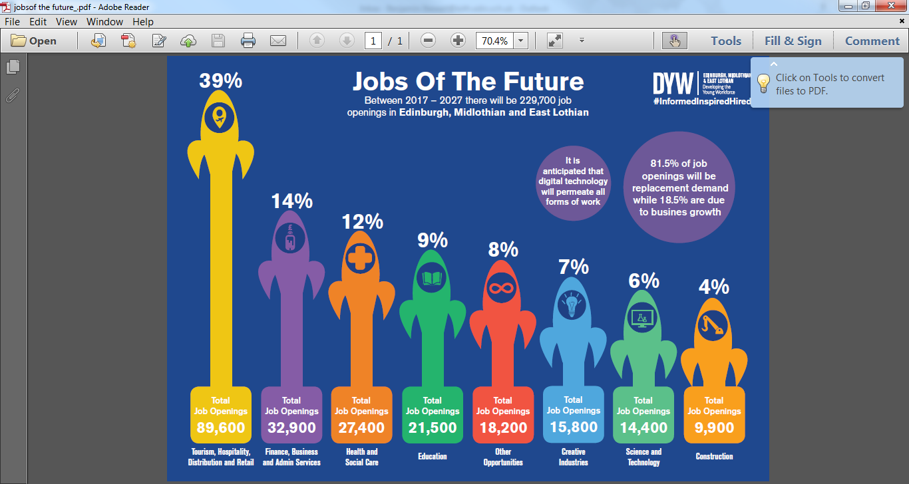

Slide 24
Careers Advisor – Giles Macnair
Skills Development Scotland – Scotland’s national careers service
Careers Advisor – supporting students to develop career management skills and to put a plan in place so they know what their next step is
Career Management Skills – developing the skills and confidence to navigate your own unique career path

Slide 25
Career Management Skills
Developing Career Management Skills allows students to make informed career decisions now, and in the future.
We face career decisions throughout our lifetimes – including our subject choices. Remember, our subject choices can help us take the next step from school but doesn’t define it.
Industry 4.0 - Advances in technology continue to change the demand for skills and create new ways of working. This is likely to result in frequent disruption in the labour market that requires recurring occupational change and a need to significantly and regularly retrain and upskill.

Slide 26
Pathways
Other Formal Training
Volunteering
Apprenticeships
University
Employment
College

Slide 27
Careers Service
To contact Giles, please email: giles.macnair@sds.co.uk
Careers website: www.myworldofwork.co.uk
SDS offer free Careers Information, Advice and Guidance to customers of all ages.

Slide 28
Factors Affecting Choices
DO:
Don’t:
Speak to staff.
Seek advice from others.
Go for a breadth of subjects.
Continue with subjects you like/are good at.
Consider future plans.
Just pick what your friends pick.
Go for “easy” subjects.
Lack ambition.
Hope for a particular teacher.

Slide 29
S2 into S3 Learner Pathway

Slide 30
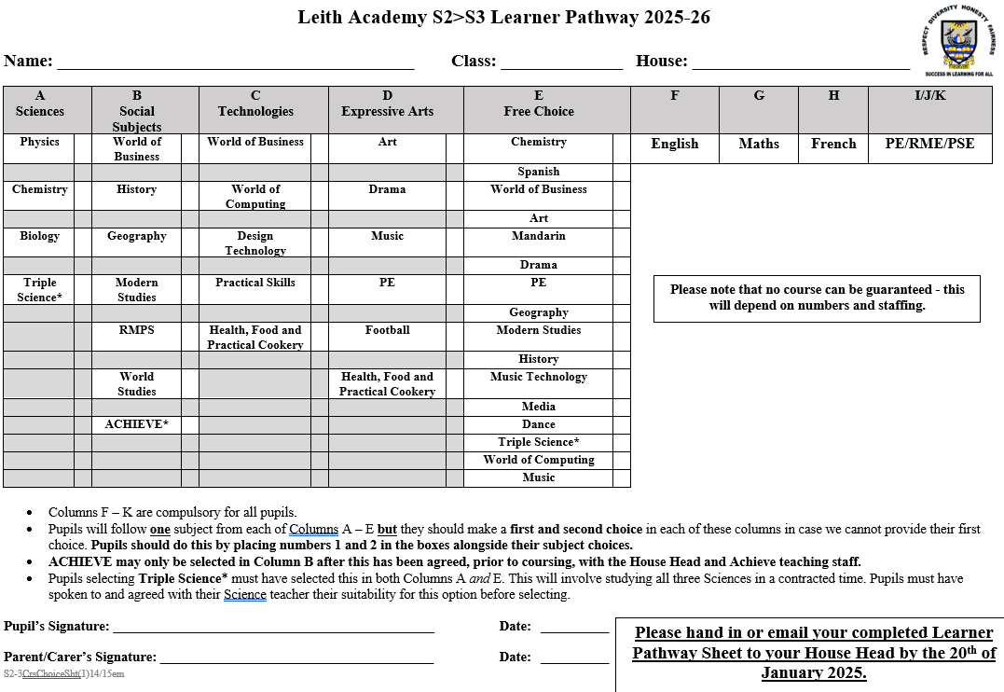

Slide 31
Options or combinations not obviously available on the LP:
Contact your House Head and we will see what we can do…

Slide 32
S2 Parents’ Evening: 16th January
http://www.parents-booking.co.uk/leithacademy
“Known as” name and legal surname
Date of birth
Email

Slide 33
Questions?

