Slide 1
LEITH ACADEMY
LGBT CHARTER TRAINING
Supporting Transgender Young People In School
Staff Briefing

Slide 2
WHAT IS THE LGBT YOUTH SCOTLAND SCHOOL CHARTER?
The LGBT Charter is a programme that enables our school to proactively improve LGBT inclusion for staff, learners and families through meeting set goals and standards set out by LGBT Youth Scotland. Our goal in undertaking this programme is to ensure all staff, parents/carers and young people are safe, supported and included.
We are working towards the GOLD award through the Charter programme.
This journey towards achieving this award signifies to staff, pupils and guardians that Leith Academy is a safe space for all learners.

Slide 3
LGBT YOUTH SCOTLAND –
LGBT AWARENESS TRAINING
As part of the LGBT Charter programme, many staff received two rounds of training to help us learn and develop our understanding of LGBTQ+ identities and the experiences of LGBTQ+ young people in schools.
This briefing aims to share key lessons from the Supporting Transgender Young People in Schools Training, which focuses specifically on the experiences of trans young people in schools.
Notes:
This is here to explain how that training impacts the school and this briefing is born out of staff doing that training.

Slide 4
WHY IS THIS BRIEFING IMPORTANT?
As practitioners, we have a professional responsibility to ensure all young people feel included, respected and supported. It is important for all staff to feel confident about supporting young people with a wide variety of needs.
Briefing all staff about transgender identities helps build staff confidence and gain a greater understanding around supporting trans young people. Having all staff feel increasingly confident in supporting trans young people allows for a consistent whole school approach.

Slide 5
WHAT IS COVERED IN THIS BRIEFING?
This session will cover:
LGBTQ+ Terminology
Professional Responsibilities
Overcoming Barriers to Education
Coming Out
Pronouns
Deadnaming
P.E. and Social Dance
SEEMiS
Transphobic Bullying
Action Plan
Inclusive Curriculum
Useful Resources
Support Available for Young People
Please read each slide. When you revisit, you can use the hyperlinks to jump to specific sections.

Slide 6
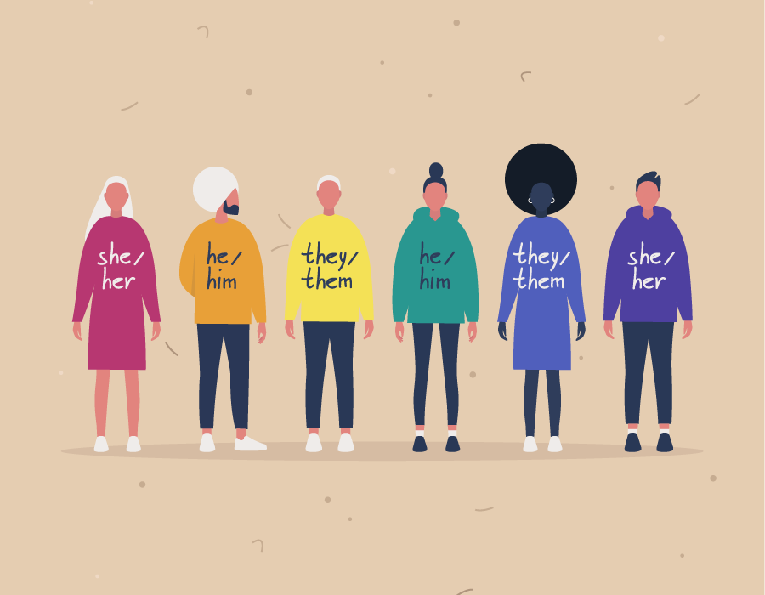
LGBT TERMINOLOGY
GENDER IDENTITY
Gender Identity: Refers to a person's innate sense of their own gender. This may or may not correspond to the sex assigned at birth. To better understand gender identity, it can be helpful to stop thinking of gender as ‘binary’ (composed of only 2 things), but as a much more complex and nuanced concept shaped by culture, society and history.
Gender Expression: Refers to how someone expresses their gender identity to the world. This can include expressing themselves through clothing, makeup and behaviours such as body language and voice.
Notes:
Further Explanation:
Gender identity:
Transgender: Some people transition socially, changing their name and pronouns. There can be many barriers to medical transition and for some trans people it's not the right path for them. You should always use the gender someone's identifies with and you might need to ask what pronouns they prefer; we'll get more into understanding pronouns soon. Some people get a bit confused by language around trans people, to help clarify, a trans woman is someone who was assigned male at birth but identifies as female and a trans man is some who was assigned female at birth but identifies as a male.

Slide 7
Transgender: An umbrella term for someone whose gender identity or expression differs in some way from the sex assigned to them at birth. Transgender is commonly shortened to Trans.
A trans person does not need to have undergone medical surgery to identify as trans.
Non-Binary: People who do not identify exclusively as male or female or fall into the ‘gender binary’. Non-binary can be used as an umbrella term for other identities such as gender non-conforming, genderqueer, genderfluid.​ Some non-binary people may use gender neutral pronouns such as they/them.
Notes:
Further Explanation:
Non-Binary: Some people view gender as a one dimensional spectrum with male at one end, female on the other, and non-binary in the middle – but the reality is that gender is more complex. There are many different ways to be non-binary and all are valid. Some non-binary people might identity as a mix of both male and female whilst others do not identity as either male or female and prefer to sit outside of the binary altogether. There are also non-binary people who might be gender-fluid, so their gender might change over time. Non-binary people may use the pronouns they/them or may use different pronouns depending on how they identify at the time. We asked a staff member to explain what non-binary means to them and they simply said, 'Identifying as non-binary means there is no set of expectations to live up to, I just get to be me...’
Cisgender: People who are cisgender do not need to identify with this term but it may be helpful for conversations with young people to avoid using the term ‘normal’ as this implies that transgender and non-binary young people are ‘abnormal’ which is stigmatising language

Slide 8
Queer: An umbrella term used for diverse sexual orientations or gender identities that are not heterosexual and do not fit within a gender binary.
Cisgender: Individuals who have a match between the sex they were assigned at birth, their bodies and their personal identity. By having a term for people whose gender identity matches their assigned sex at birth we can avoid using descriptions such as 'trans people' and 'normal people'. Instead, we can talk about transgender (trans) people and cisgender (cis) people.
Notes:
Further Explanation:
Queer:
Queer identity can relate to both sexual orientation and gender identity. It is a term that has been reclaimed by the LGBT community but should be used with caution as some people still might find it offensive. As always, it is best to mirror language with young people, if someone describes themselves as queer then you can mirror this language back to them.
has historically (and still now) been used in a derogatory way. ​
Because of the historical context of the word and different people have different relationships with the word, don’t be surprised if people use this about themselves. But be mindful of how you use this word and around who. ​
This is not a word you need to use if you makes you uncomfortable, but important to know it’s okay in the right context. ​
Reclamation of language – 80s New York.​
Politically charged word​
Intersex: Key Learning:​
Also know as VSC (Variations of Sex Characteristics).​
Over 1 in 2000 people are intersex (Around 1.7% world population). ​
People usually think of sex as two distinct categories (XX and XY). Intersex can be related to chromosomes, hormones or secondary sexual characteristics​
Gender, Sexuality and Intersex Status are all different things and can combine in different ways​
Fun fact: Around 2% of the population are intersex; about as common as redheads! (if you have met a redhead, you’ve probably met an intersex person too)​
​
Potential Issues:​
How will people know if they are Intersex? Parents may learn prenatally through the use of genetic screening technologies, at birth or in early childhood at puberty. Others find learn later in life – for example when trying to conceive a child. Some people might never know they have an Intersex Status.​
Is that like a hermaphrodite? We don’t use this language anymore and could be considered a slur for Intersex people. (Hermaphrodite means consisting of both sexes at the same time), Intersex is a lot more than that! As we have said language evolves and we should respect people with those lived experiences. ​

Slide 9
Gender Dysphoria and Euphoria
Some young people you work with may talk about their experiences of 'gender dysphoria' and/or 'gender euphoria'. Here are what these terms mean:
Gender Dysphoria: A term used to describe when a person experiences discomfort or distress because there is a mismatch between their sex assigned at birth and their gender identity. We will discuss how you can support young people experiencing gender dysphoria later in the course.
Gender Euphoria: a term used to describe when a person feels happy and confident in the way their body looks and feels, and in how they are perceived socially. This can be affirming of their gender identity.
Notes:
Further Explanation:
Queer:
Queer identity can relate to both sexual orientation and gender identity. It is a term that has been reclaimed by the LGBT community but should be used with caution as some people still might find it offensive. As always, it is best to mirror language with young people, if someone describes themselves as queer then you can mirror this language back to them.
has historically (and still now) been used in a derogatory way. ​
Because of the historical context of the word and different people have different relationships with the word, don’t be surprised if people use this about themselves. But be mindful of how you use this word and around who. ​
This is not a word you need to use if you makes you uncomfortable, but important to know it’s okay in the right context. ​
Reclamation of language – 80s New York.​
Politically charged word​
Intersex: Key Learning:​
Also know as VSC (Variations of Sex Characteristics).​
Over 1 in 2000 people are intersex (Around 1.7% world population). ​
People usually think of sex as two distinct categories (XX and XY). Intersex can be related to chromosomes, hormones or secondary sexual characteristics​
Gender, Sexuality and Intersex Status are all different things and can combine in different ways​
Fun fact: Around 2% of the population are intersex; about as common as redheads! (if you have met a redhead, you’ve probably met an intersex person too)​
​
Potential Issues:​
How will people know if they are Intersex? Parents may learn prenatally through the use of genetic screening technologies, at birth or in early childhood at puberty. Others find learn later in life – for example when trying to conceive a child. Some people might never know they have an Intersex Status.​
Is that like a hermaphrodite? We don’t use this language anymore and could be considered a slur for Intersex people. (Hermaphrodite means consisting of both sexes at the same time), Intersex is a lot more than that! As we have said language evolves and we should respect people with those lived experiences. ​

Slide 10
KEY POINTS FROM LGBTYS TRAINING
1. It is okay to make mistakes and be honest if you are not sure of certain terms, if a young person is identifying with a term you are unsure of, ask what that term means to them. Definitions can help but understanding what a word means to someone and how they use it is what’s most important.
2. Identity cannot be assumed and you should not assume young peoples’ sexual orientation and gender. It’s best to ask a young person the name they go by and pronouns they use.
3. Provide platforms for young people to voice their experiences of LGBTQ+ issues and identity within the school.
Notes:
Delivery notes
Expand on these points using the info below:
Mistakes: LGBT terminology and discourse can change and it is okay if a term is used that may be outdated, the important thing is to learn and know what language makes the young people around you comfortable. If you slip up with terminology or names and pronouns , apologise and move on. Fear over making mistakes should never deter you from having these important conversations with young people.
Identity: Using the correct name and pronouns is about respect for that young person, it does not have to be a complicated issue. It is okay to make mistakes as long as you apologise and correct yourself then move on from the situation, the important part is to try. This can be helped by having introductions to classes where names and pronouns are shared. It is also important to note that a young person may not be ‘out’ to friends and family so if they ask you to use certain names and pronouns you should ask if that’s what they are to be called when speaking to home or in report cards.

Slide 11
KEY POINTS FROM LGBTYS TRAINING
4. Always challenge language that could be considered homophobic, biphobic or transphobic. If you hear a comment in the hall or playground but do not have time to address it then and there, make a note of the incident and address it later. It is also helpful to inform the pupil’s House Head and/or DHT so that they can take appropriate steps to address the issue and provide support/education.
5. Have posters and signs to indicate that the classroom is a safe space for LGBTQ+ pupils; this could be as simple as a small poster in the classroom or flag on the desk. At Leith Academy, we can use our LGBT+ Welcome signs to do this and these are available from Ben Stewart. Staff could also wear rainbow lanyards to signify to young people that their teacher is an ally if they like.
Notes:
Delivery notes
Expand on these points using the info below:
Language: Language is powerful and can often reinforce stereotypical messages. Dividing a class by ‘boys’ and ‘girls’ can be distressing for trans/non-binary pupils. We should never ignore judgmental and harmful language. Ensure that you help pupils to understand why they shouldn’t use harmful language rather than just making them avoid using it around you. Pupils should know that if they use the word ‘gay’ as an insult it will be treated as homophobic bullying and dealt with accordingly
Visibility: Small everyday things that visibly show you are an LGBT ally can have the greatest impact in creating an inclusive environment. Wearing or displaying these items also signifies you are someone who pupils can trust within the school.

Slide 12
KEY POINTS FROM LGBTYS TRAINING
6. Think about your language. Do you use gendered terminology in class such as ‘Hello, boys and girls’? Little changes can make a difference. Try using gender neutral terms when addressing students such as ‘folks’ or ‘everyone’. Try also avoid using terms that reinforce gender stereotypes e.g. ‘can I have some strong boys move these tables?’
7. Take your time - change does not happen overnight and it is important that the changes being made can be implemented long term. We are on a journey as a school and the Charter is here to support our work.
Notes:
Delivery notes
Expand on these points using the info below:
Language: Language is powerful and can often reinforce stereotypical messages. Dividing a class by ‘boys’ and ‘girls’ can be distressing for trans/non-binary pupils.
Time: Emphasise this is a journey, once that involves cultural change as well as practical changes and will emerge over time. Undertaking the LGBT awareness training is a commitment to this change.

Slide 13
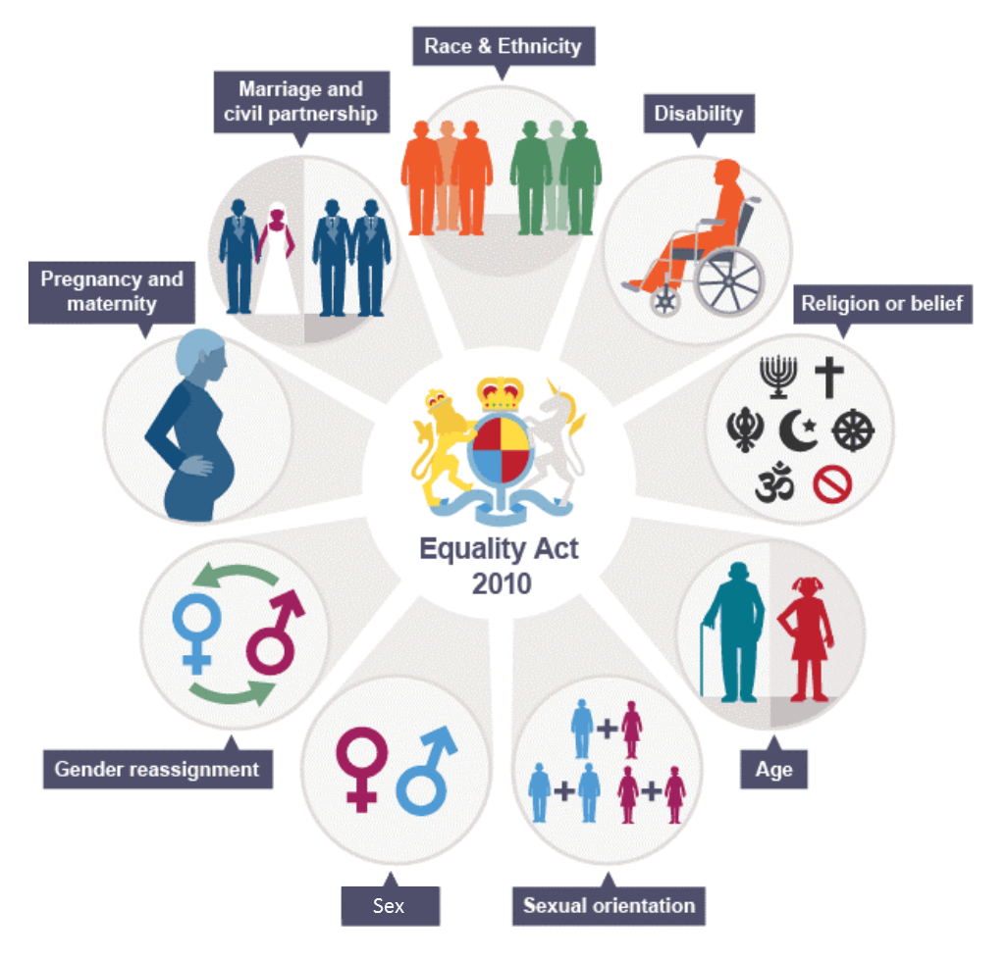
PROFESSIONAL RESPONSIBILITIES
Undertaking the LGBT Youth Scotland Charter Programmes aids us as professionals in upholding the principles of the following legislation, policy and guidelines:
The Equality Act (2010)
“The Act creates a duty on public bodies to have due regard to the need to:
Eliminate discrimination, harassment and victimisation;
Advance equality of opportunity; and, to foster good relations between people who share a relevant protected characteristic and those who do not.” Scottish Government
Notes:
Do not need to read out quotes

Slide 14
PROFESSIONAL RESPONSIBILITIES
Getting it Right for Every Child (GIRFEC)
“At home, in school or the wider community, every child and young person should be:
Safe, Healthy, Achieving, Nurtured, Active, Respected, Responsible, Included” The Scottish Government
GTCS Standards for Registration
“Commit to and demonstrate equity and inclusion to advance equality of opportunity between learners who share a relevant protected characteristic and those who do not and foster good relations;” GTCS Standards for Full Registration 3.2.3
Notes:
Do not need to read quotes

Slide 15
PROFESSIONAL RESPONSIBILITIES
The United Nations Convention on the Rights of the Child (UNCRC)
Article 2: The Convention applies to every child without discrimination, whatever their ethnicity, gender, religion, language, abilities or any other status, whatever they think or say, whatever their family background.
Article 13: Every child must be free to express their thoughts and opinions and to access all kinds of information, as long as it is within the law.
Article 29: Education must develop every child’s personality, talents and abilities to the full. It must encourage the child’s respect for human rights, as well as respect for their parents, their own and other cultures, and the environment.
Notes:
If you have a Rights Respecting School award this could be a really important slide to focus on
These are not the only articles that are relevant to supporting LGBT young people , many more can be relevant.

Slide 16
PROFESSIONAL RESPONSIBILITIES
5. Supporting Transgender Pupils – Scottish Government Guidance
This guidance outlines both why schools have a responsibility to support transgender and non-binary young people but also provides guidance on what this support should look like in schools.
“Children have the right to information that is important to their health and
wellbeing. For transgender young people, this includes telling them about the support available”
“Schools have a key role in keeping transgender young people safe from bullying, including transphobic bullying”
The Scottish Government

Slide 17
OVERCOMING BARRIERS TO EDUCATION
Coming Out
Telling someone about an LGBTQ+ identity is often referred to as ‘coming out’. The process of coming out is different for everyone; it can take some time to get to a point where someone feels comfortable enough to have those conversations with the people around them.
Just because someone decides to come out to family or friends, does not mean they have to come out to everyone. This is not a Child Protection issue or a Wellbeing Concern. It is quite common for someone to be out in certain areas of their life but not others. It is important that you respect this, and do not push someone to come out if they are not ready to do so, nor inform other people of someone’s LGBTQ+ identity without their consent; this is known as ‘outing’.

Slide 18
OVERCOMING BARRIERS TO EDUCATION
Arrange a time to meet up again, to check in and see how they are doing
Say 'thank you': the fact that they have trusted you enough to speak to you is a privilege
How can I support someone who is coming out?
Ask what name and pronoun you should use to address them
Ask what support you can give: listen to what they say, and repeat it back to check you've understood correctly

Slide 19
OVERCOMING BARRIERS TO EDUCATION
This is just a phase
Are you sure?
Phrases to avoid
How do you know?
The young person has likely spent a long time considering their identity before coming out to a trusted adult and it is important that they feel listened to, respected and supported.

Slide 20
OVERCOMING BARRIERS TO EDUCATION
Pronouns
We use pronouns most often when referring to someone without using their name. Commonly used pronouns (he/she) specifically refer to a person’s gender. For transgender young people, these pronouns may not fit, can create discomfort, and can cause stress and anxiety.
It is important to use someone’s new name and pronouns even if they are not around. Mistakes will happen, and you may use the wrong name or pronoun by accident, but that’s okay! Just apologise, correct yourself and move on.

Slide 21
OVERCOMING BARRIERS TO EDUCATION
Deadnaming
The term ‘dead name’ is used to refer to the name that a transgender person used before transitioning, such as their birth name. Deadnaming can be done unintentionally, or can be done deliberately to deny, mock or invalidate someone’s transgender identity.
It is normal to make mistakes when a transgender person first changes their name or pronouns; it will take time for you to re-learn the correct ways of referring to that person. It is important that you try your best to use the correct name and pronouns, even when the person isn’t present.

Slide 22
OVERCOMING BARRIERS TO EDUCATION
Trans Inclusive P.E. and Social Dance
P.E. and Social Dancing (such as Ceilidh dancing) can be a gendered experience. For pupils who do not identify as male or female, or are questioning their gender identity, this can be a particularly difficult aspect of the school experience.
Things you can do to help:
Avoid using gendered language (e.g. ‘boys and girls’)
Avoid splitting classes into gendered groups
Pairings for social dance could be ‘Leader’/’Follower’ or ‘Number 1’/’Number 2’
If the school can provide gender neutral or individual changing spaces for any pupil who would like one, then that option should be explored. If this is not an option, and if a learner does not feel comfortable or included in that specific space, alternative arrangements should be discussed to meet the learners needs.

Slide 23
OVERCOMING BARRIERS TO EDUCATION
SEEMiS
SEEMiS (or any school recording system) can be used in many ways to support transgender young people such as by logging bullying incidents and changing name and gender markers to reflect the gender identity of students.
Under 16s Guidance
Parental consent is needed for a formal name change, i.e. changing First Name field on SEEMiS
Pupils can request an informal name change using the ‘Known As’ section on SEEMiS
Note that informal name changes are reflected on ParentPay and other linked services. Pupils should be consulted before transferring information between these platforms
It's important to encourage the young person to speak with their parents or carers about their desire to change their name if they feel safe to do so.

Slide 24
OVERCOMING BARRIERS TO EDUCATION
Over 16s Guidance
Parental consent is not needed for a formal name change, i.e. changing First Name field on SEEMiS
Pupils can still request an informal name change using the ‘Known As’ section on SEEMiS
Encourage the young person to talk to their parents/carers if they feel safe to do so. Let them know that formally changing their name means that all correspondence from school to their parents/carers will now use their new name
This content is a brief overview of the information on page 22-25 of the Supporting Transgender Pupils in Scottish Schools guidance. Go to these pages to find out more.

Slide 25
OVERCOMING BARRIERS TO EDUCATION
Transphobic Bullying
Transphobia can be defined as a dislike of or prejudice against transgender people. Transphobic bullying can be defined as behaviour or language that makes a person feel hurt, threatened, frightened and left out because of their perceived or actual gender identity. This can include denying the validity of their gender identity or refusing to accept a gender identity.
Responding to Transphobic Bullying
Bullying incidents can sometimes remove young people's agency and that can disengage young people from the process. It is important that young people being bullied have a say in how this situation is addressed and you should always ask for their view on how they would like things to proceed. All instances of transphobic bullying must be recorded and reported to the relevant House Head and/or DHT. This can be email, Wellbeing Concern Form or direct conversation,

Slide 26
OVERCOMING BARRIERS TO EDUCATION
When responding to young people who are perpetrating transphobic bullying, you may want to ask reflective questions such as:
Do you understand why what you did may have been hurtful?
Please explain why you (insert action here)?
What do the words you used mean and did you intend for them to harm somebody else?
What needs to change to ensure this does not happen again?
Take time to have discussions with the young person and aim to expand their understanding of why transphobic bullying is harmful. You may also want to include specific lessons on Gender Identity and Transphobic Bullying in PSE classes to ensure all learners are expanding their knowledge and understanding of trans/non-binary identities and experiences.

Slide 27
ACTION PLAN AT LEITH ACADEMY
As part of Leith Academy’s work toward the GOLD Charter Award,we will be using the knowledge and experience gained from the Supporting Transgender Young People in School Training to form our Action Plan moving forward.
Creating an Action Plan is a goal we need to achieve for the LGBT Charter Programme.

Slide 28
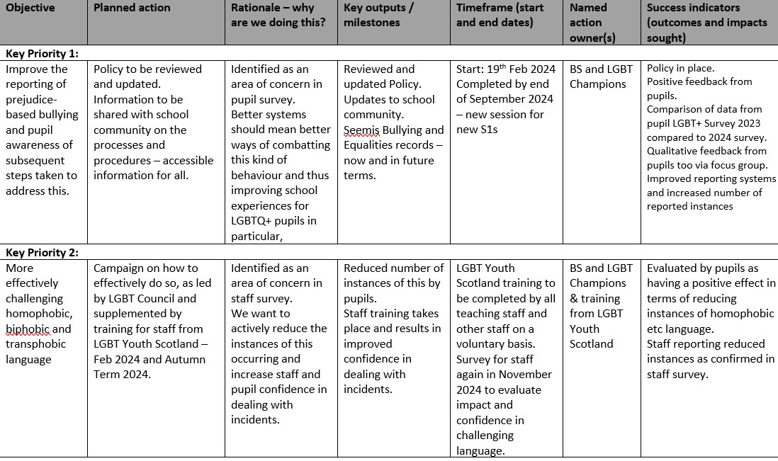
ACTION PLAN for LEITH ACADEMY:
Notes:
Fill in the action plan and explain the actions

Slide 30
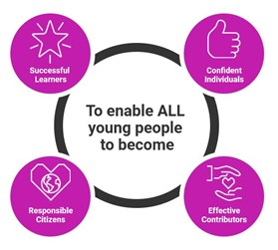
CURRICULUM INCLUSION
Want some ideas on how the curriculum can be more LGBTQ+ inclusive? See our tips and ideas for different subjects on the following slides…
Notes:
Would recommend this part is sent out to staff rather than delivered live.

Slide 31
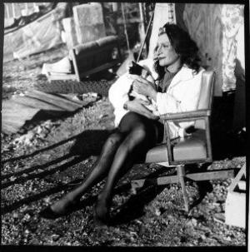
EXAMPLES OF CIRRICULUM INCLUSION
Trans Icons
Having positive role models that are inclusive of all gender identities and celebrating their achievements can be incredibly beneficial for young people and improve their views on their own wellbeing and future.
History – Sylvia Rivera
Sylvia Rivera was a leader during the 1969 Stonewall Inn uprising. She fought against the exclusion of transgender people, especially transgender people of colour, from the larger movement for gay rights. Along with Marsha P. Johnson, Rivera started the Street Transvestite Action Revolutionaries (STAR) around 1971. The group became a space to organise and discuss issues facing the transgender community in New York City and they also had a building, STAR House, that provided lodgings for those who needed it.

Slide 32
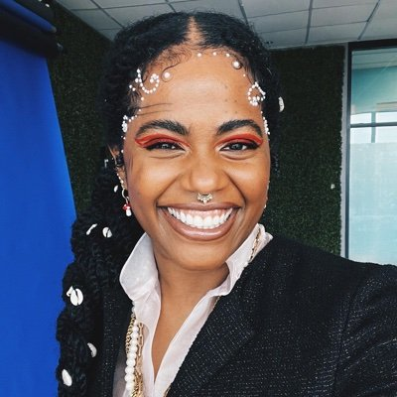
EXAMPLES OF CIRRICULUM INCLUSION
English – Akwaeke Emezi
Featured on the cover of TIME Magazine as a 2021 Next Generation Leader, Akwaeke Emezi is a Nigerian non-binary multidisciplinary artist and writer. They are the author of books such as ‘Freshwater’ and ‘Pet’ which was a finalist for the 2019 National Book Award for Young People's Literature and a Lambda Literary Award. Their work has earned them several awards and nominations including the Otherwise Award and Commonwealth Short Story Prize.

Slide 33
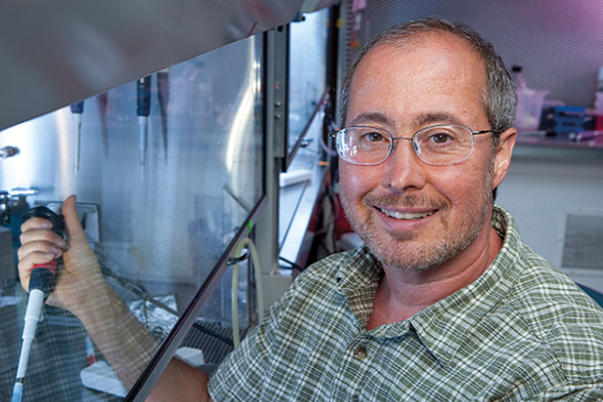
EXAMPLES OF CIRRICULUM INCLUSION
Sciences – Ben Barres
Ben Barres was a neurobiologist at Stanford University who was acclaimed for his discoveries of the roles played by glia cells. In showing how important glia are, Barres revolutionized the understanding of the brain. Barres repeatedly spoke up for groups who have been historically marginalized in the sciences, including women, minorities, and LGBTQ+ people.
He would repeatedly talk about the biases
and systemic barriers that keep such
groups from succeeding in careers
within the science. Barres was the
first transgender scientist to be
elected to the National Academy
of Sciences.
Notes:
Link to report found through picture

Slide 34
EXAMPLES OF CIRRICULUM INCLUSION
Using Gender Neutral Examples
Using gender neutral examples and they/them pronouns in resources is a great way of having subtle visibility. This can be done in multiple subject areas such as Maths, English and Modern Languages.
Example:
In Modern Languages you could discuss how many European languages have grammatical gender constructs, most notably nouns being assigned 'male' or 'female'. You could also discuss the recent inclusion of the gender-neutral pronoun 'iel’
in a major French dictionary and
comment on how language is
changing to be more inclusive of
non-binary identities.

Slide 35
EXAMPLES OF CIRRICULUM INCLUSION
Inclusive Science and RSHP Lessons
Science classes around human reproduction, anatomy, puberty, and sex can often be presented in a very binary way. Feedback from young people suggests that these classes can be an uncomfortable experience particularly when language is used that reinforces a gender binary. It is important to consider the following questions when looking at your science and RSHP curriculum:
Is the language used inclusive of all students?
Are lots of different relationships represented during sex education?
Does the course frequently refer to ‘men’ and ‘women’ when it doesn’t need to?
Are intersex people mentioned when talking about anatomy, hormones and gender?
Are trans people visible within the curriculum?
Can points be rephrased to be more trans inclusive?

Slide 36
EXAMPLES OF CIRRICULUM INCLUSION
Trans Inclusive Books
Displaying books that discuss gender identity or have gender diverse characters in them is a great way to communicate inclusive messages to young people and provide visibility in your school.
You may wish to mark books which are LGBTQIA+ inclusive through specific stickers or through a specific section in the library/classroom.
Check out our Primary School Booklist and Secondary School Booklist.

Slide 37
EXAMPLES OF CURRICULUM INCLUSION
Classroom Visibility
Having visibility within classrooms can indicate the classroom is a safe space for trans young people.
Including your pronouns when introducing yourself or including them in your email signature
Displaying LGBTQ+ inclusive posters
How can you make your classroom more visibly inclusive?
Displaying different pride flags around your classroom
Wearing a rainbow or trans flag lanyard
Find printable resources here.

Slide 38
EXAMPLES OF CIRRICULUM INCLUSION
Using Gender Neutral Language
Not all subjects lend themselves to studying specific topics or people that are relevant to trans young people, however there are many other ways to ensure classroom content is inclusive such as using gender neutral language.
To make your classroom environment more inclusive of transgender identities, you can use gender neutral language when addressing your pupils or delivering curriculum. Here are a few examples:
Replacing ‘he/she’ with its gender neutral counterpart, ‘they’
Use ‘everyone/everybody’ or other alternatives to ‘boys and girls’
Avoid splitting groups by gender; you can split them by numbers or activity instead

Slide 39
CURRICULUM INCLUSION
Click the links on this page for more resources and guidance on LGBTQ+ curriculum inclusion.
Resources
LGBTYS Curriculum Inclusion https://www.lgbtyouth.org.uk/media/1585/lgbtys-curriculum-inclusion.pdf
LGBT Education Website
https://lgbteducation.scot/
PSE resources
https://rshp.scot/

Slide 40
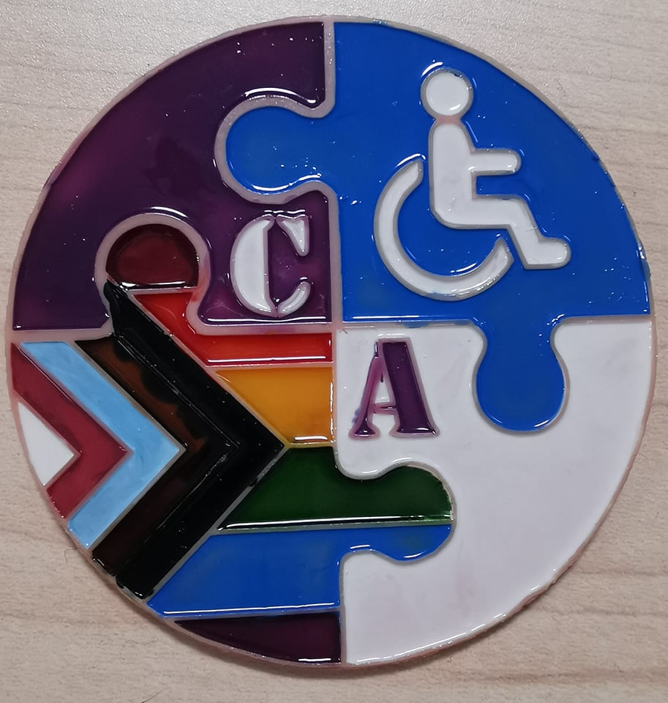
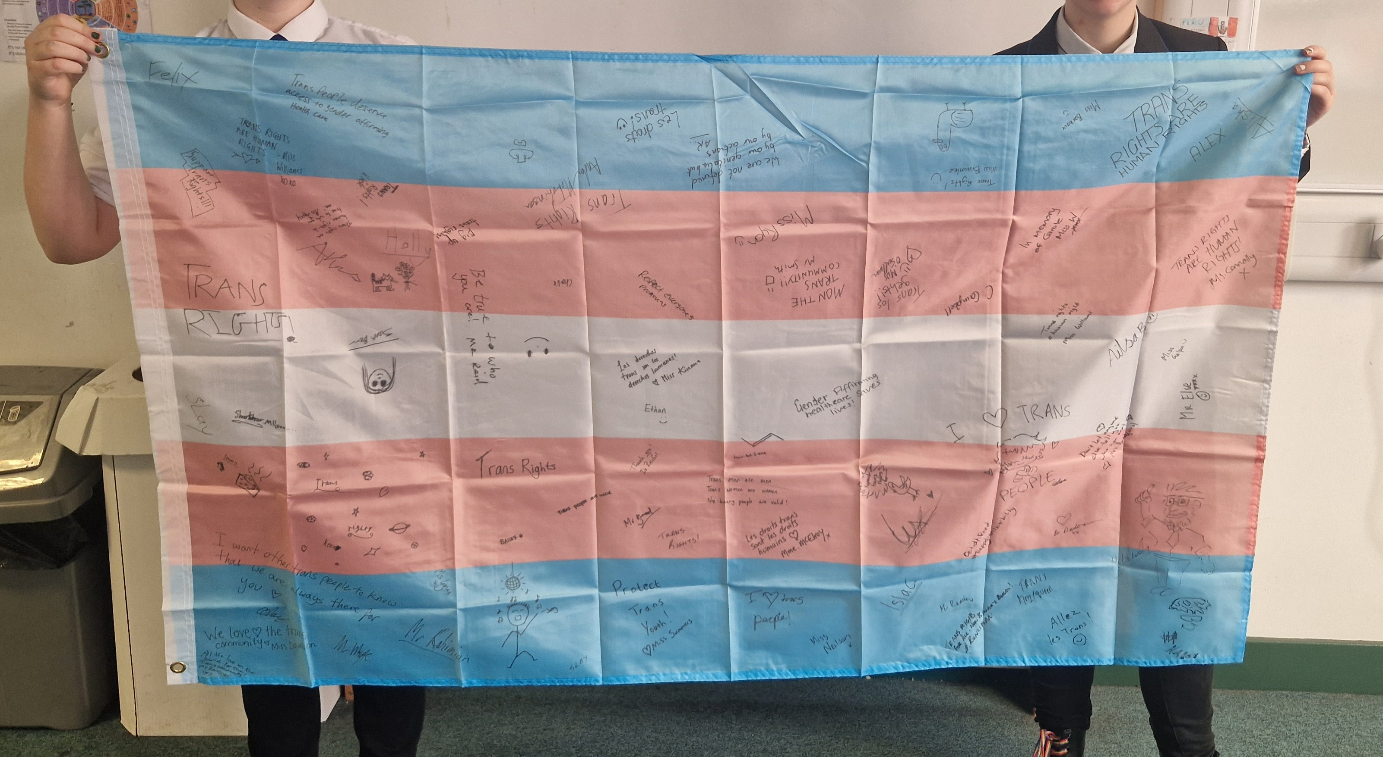
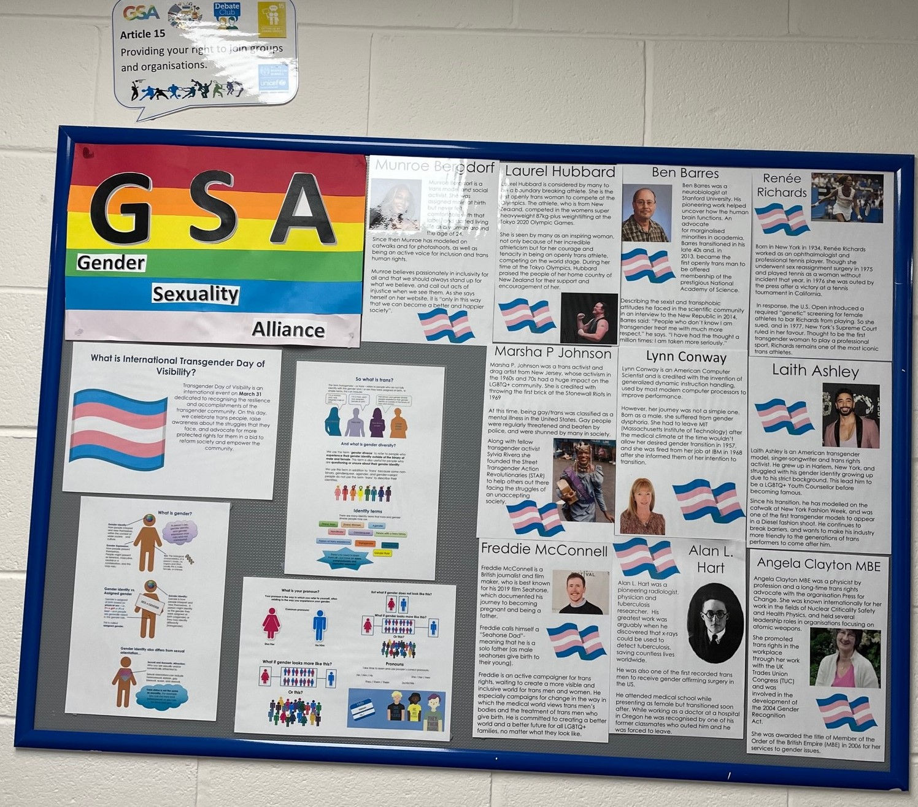
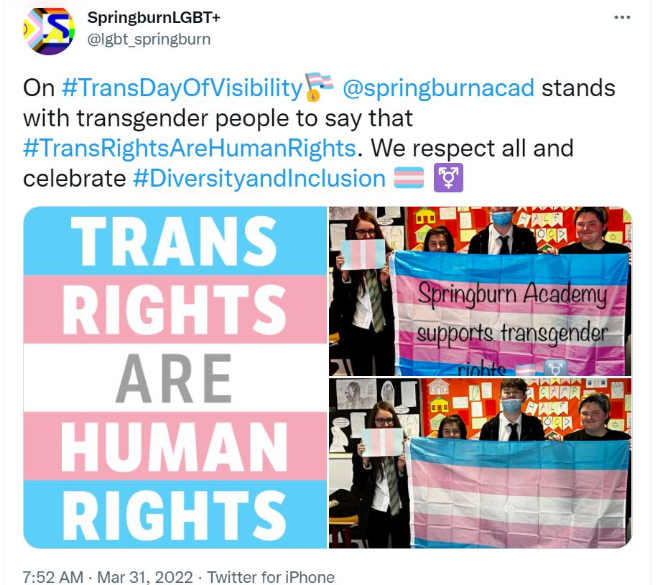
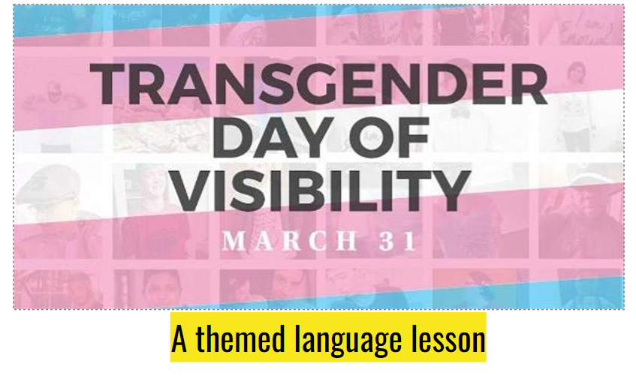
EXAMPLES OF LGBT INCLUSION FROM OTHER SCHOOLS
Trans Flag Signing – Firhill High School
Inclusive bathroom sign – Cumbernauld Academy
Trans Icons Display – Balerno High School
TDOV English Lesson – Eastwood High School
Trans Day of Visibility (TDOV) – Springburn Academy
Notes:
Different ideas for actions to take forward in the school if possible – more examples can be found on the LGBT Charter Hub by the Charter Champions
Portobello High School: Designed Posters in Art that had links with LGBT imagery such as the pride flag
Broomhill Primary School: This school created a movie showcase. Young people were to make films around anti-bullying. They created tickets and gave out popcorn for the event. Some students animated these films and others made live action films.
Stonelaw High School: Different year groups participated in creating a pride flag with pupils’ handprints. This was then displayed in the school.
Castlehead High School: Created an LGBT Charter Board to showcase their highlights in their Charter journey. This included work made by pupils.
The Mary Erskine School: The school organised a pride run, running with the pride flag and dressing in bright colours for the occasion.

Slide 41
RESOURCES
To help us achieve these actions the following resources can be used for support and provide additional information.
Resource | Description
Curriculum Inclusion: LGBT Mapping Across Curriculum for Excellence | Provides practical examples of how the CfE can be inclusive of LGBT identities. This document gives practical examples of LGBT inclusion across a wide range of the curriculum.
10 Top Tips for Creating an Inclusive School Environment | Provides guidance to both primary and secondary schools on how to create an inclusive school environment.
Top Tips for Trans Inclusion in Youth Work Spaces | Practical advice to help make your setting inclusive for trans and non-binary young people.
Notes:
Resources span over 3 slides

Slide 42
RESOURCES
Resource | Description
Involving Parents and Carers in LGBT Work | Guidance for primary and secondary schools in involving parents/carers in LGBTQ+ inclusion work and creating an inclusive school community.
Scottish Government LGBT Education Website | A hub for LGBTQ+ inclusive education resources and included resources from LGBTYS, TIE, Scottish Government and many others.
Supporting Transgender Pupils in Schools – Scottish Government Guidance for Schools | Official guidance from the Scottish Government on how to best support transgender young people in education. It gives advice on how to support pupils and families, coming out, transphobic bullying and inclusion within the school environment.
Notes:
Resources span over 3 slides

Slide 43
RESOURCES
Further resources including lesson plans and activities can be found at the two websites below:
https://www.lgbtyouth.org.uk/resources/
https://lgbteducation.scot/
Notes:
Other resources on LGBTYS resources site:
Pronoun Posters
Shhh! Silence Helps Homophobia lesson
Starting a GSA advice
Lessons and Assemblies made by LGBTYS
LGBT Education:
Free training
Primary and Secondary resources
Government Guidance

Slide 44
SUPPORT FOR TRANS YOUNG PEOPLE
It is important that school staff and young people know what support is available for young people who might be after some advice or even just to connect with like-minded young people. The next few slides will cover support that is available in the school and more widely in Scotland.
1. Equalities Ambassadors – 70+ students trained to champion and celebrate diversity whilst safely but actively challenging prejudice of all kinds.
2. SPECTRUM – Our LGBT+ Pupil Group – a safe space for all of our LGBT+ students and active contributors to our Charter work. They meet Monday lunchtimes in Drama.
2. Youth Groups A number of LGBTQ+ youth groups run across Scotland, find your local youth group using this link - https://www.lgbtyouth.org.uk/groups-and-support/find-local-youth-groups/
Notes:
(As of October 2021 some youth groups are in person particularly in the Central Belt)

Slide 45
SUPPORT FOR LGBT YOUNG PEOPLE
3. Digital Youth Work
LGBT Youth Scotland offer a wide variety of online support to young people.
This includes a digital chatline for young people (see image), a Discord server for youth groups for LGBTQ+ young people to connect and 1 to 1 online support sessions. Young people can use these services directly or a referral can be made by emailing: info@lgbtyouth.org.uk
Notes:
These Live Chat Times are subject to change based on demand

Slide 46
SUPPORT FOR LGBT YOUNG PEOPLE
Many other organisations have useful information and helplines for LGBTQ+ young people:
Time for Inclusive Education: https://www.tie.scot/
Stonewall Scotland: https://www.stonewallscotland.org.uk/
Scottish Trans : https://www.scottishtrans.org/community/
LGBT Health and Wellbeing: http://lgbt-helpline-scotland.org.uk/ . The LGBT Helpline is open every Tuesday and Wednesday between 12-9pm on 0300 123 2523.
Mermaids: https://mermaidsuk.org.uk/helpline-support-services/. The Mermaids helpline is for transgender and non-binary youth, up to and including the age of 25. Helpline Open Monday to Friday, 9am to 9pm on 0808 801 0400

Slide 47
QUESTIONS
If you have questions you can talk to your Leith Academy Champions: Ben Stewart, Estelle Richardson, Kelly Simpson and Lisa Alan.
If you would like to support this work more, we are happy for you to join the LGBT Charter Champion group!

Slide 48
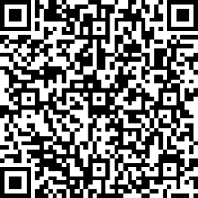
FEEDBACK
If you have used this resource or any of LGBT Youth Scotland’s other resources, we would love to hear your feedback via the link or QR code:
https://forms.office.com/r/pg2e6bUbHV

Slide 49
This presentation has been co-created by
© Copyright LGBT Youth Scotland 2011 - 2021
LGBT Youth Scotland is a charity registered in Scotland, No: SC024047 and a company limited by guarantee, No: SC244805

