Slide 1
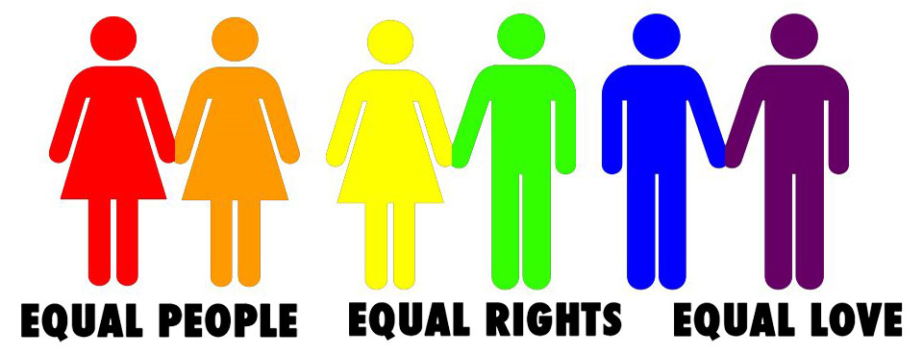
LGBT+

Slide 2
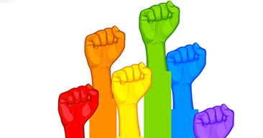
Why are we here?
Why we are here
What we are talking about
- Covering a range of topics involved with LGBT+ and what these characters mean.
What are you going to get out of this (purpose)
- inform about matters surrounding LGBT
ensure they know they can come to us with questions
Ok to feel how you’re feeling
Reiterate that we aren’t here to patronise
Here to let you know you are not alone and that you are not the only one

Slide 3
Rules
Be Respectful – don’t judge, laugh, or be homophobic. This is a serious topic.
Confidentially. No name dropping. GET SOME HELP FROM TEACHERS
You can leave at any point during the presentation if you feel uncomfortable
It is okay to ask if something is offensive

Slide 4
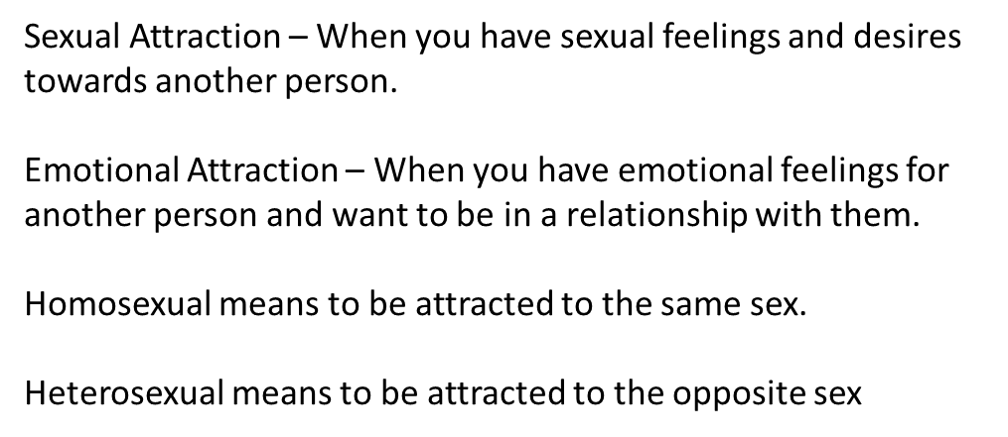
Definitions

Slide 5
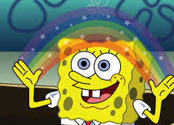
What does LGBT+ stand for?
Lesbian
Gay
Bisexual
Transgender
+ any other identities

Slide 6
Lesbian
A lesbian is a homosexual woman.
Women who experience emotional and sexual attraction to other women.

Slide 7
Gay
The term “Gay” most commonly refers to homosexual men.
Men who experience emotional and sexual attraction to other men.
Gay is the umbrella term for bisexual and homosexual men and women.
If someone who identifies as male is emotionally and sexually attracted to another male he is referred to as “gay”

Slide 8
Bisexual
A person who is emotionally and sexually attracted to both males and females.
If a person is bisexual it does not necessarily mean they like both equally as they might have a preference.

Slide 9
Kinsey Scale

Slide 10
Transgender
Someone who identifies as a gender that is different from their sexual organ.
E.g. If someone with a penis identified as female they would be referred to as transgender
There is a difference between transgender and transsexual, but it is a very fine line.

Slide 11
+
The plus represents any other terms that doesn’t come under L, G, B or T.
For example:
Asexual - a person who has no sexual feelings or desires.
Demisexual - a person who does not experience sexual attraction unless they form a strong emotional connection with someone.
Pansexual - sexually attracted towards people regardless of gender. Also known as gender blind.
Heterosexual – a person who is emotionally and sexually attracted to the opposite sex. Otherwise known as straight.

Slide 12
Stats
More than half (55 per cent) of lesbian, gay and bi pupils have experienced direct bullying
Almost all (99 per cent) gay young people hear the phrases ‘that’s so gay’ or ‘you’re so gay’ in school and 96 per cent of gay pupils hear homophobic language such as ‘poof’ or ‘lezza’
Homophobia is not just making these comments but also saying nothing when you hear them being used – Everyone has a responsibility to say something even if it is to a teacher afterwards.

Slide 13
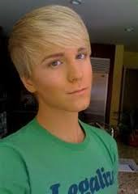
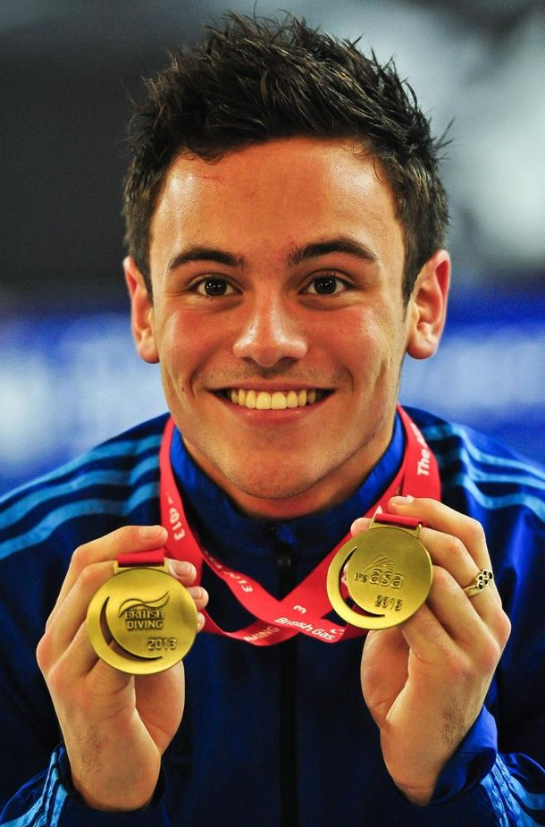
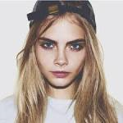
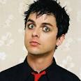
Celebrities
Sara Ramirez
Bisexual
Gigi gorgeous
Transgender Lesbian
Laverne Cox
Transgender
Ellen DeGeneres
&
Portia de Rossi
Lesbian couple
tom Daley
Gay
Billie Joe Armstrong
Bisexual
Cara Delevingne
Bisexual

Slide 14
Identity
There are five main points to remember about identity.
There is a difference between biological sex and gender identity.
you do not have to label yourself anything if you do not want to or do not feel comfortable. Do not let anyone else label you.
Gender Identity: The gender that you perceive yourself to be but it is not necessarily the sex that you were born with.
Sex assigned at birth: The sexual organ that you were born with which doesn’t always match up with your gender identity.
Gender Expression: Your gender expression does not have to match with your gender identity or sex assigned at birth.

Slide 15
Notes:
You do not have to label yourself anything if you do not want to or do not feel comfortable. Do not let anyone else label you.

Slide 16
Sexual Development
Don’t feel pressure to put yourself under a label.
Hands up if you think you are the same person as 10 years ago.. And in 10 years.
For example Gigi

Slide 17
Coming Out
For most people the hardest person to come out to is yourself.
How to come out
Why
who
When
Someone coming out to you
Thoughts………………………………………………………………………
As and when you are ready both emotionally and mentally. No time at which it has to be done. Make sure you tell someone that you 100% trust – If you are told this shows how much someone else trusts and values your friendship, be respectful of this.

Slide 18
Activities
Writing words and discussing whether offensive or not.
Agree/disagree (ask teachers)
A bisexual man gets married to a woman this makes them straight.
Calling someone gay is harmless
If a woman is masculine this does not mean she is a lesbian
Get post it notes – Have two sides of the room – negative/harmless
Post box for further questions – House Heads and LGBT team can then answer them and feedback to class

Slide 19
Support
Childline
LGBT Youth Scotland
Teachers or senior pupils you trust
Print out copies of Unicorn – also make a self help directory – with helpful tips and the contact info for above supports.

