Slide 1

Senior Phase at
Leith Academy:
S4 to S6

Slide 2
Where will you be and what will you be doing In…
1 year’s time?
5 years’ time?
10 years’ time?

Slide 3
Senior Phase at Leith Academy
Options:
Return to School – All S4 – 7 SUBJECTS In 2026-27.
Leave to seek Employment/Training/Volunteering – S5 & S6 (some S4 at Xmas)
Leave to go to College – S5 & S6 (some S4 at Xmas)
Foundation Apprenticeships - S5/6
School & College – S4*, S5 & S6

Slide 4
Returning to School
Future Plans - Next Year/2 or 3 Years
Senior Phase Handbook
SDS/My Job Scotland/My World of Work – Vital to access
https://www.myworldofwork.co.uk/
Staff/Parents/Carers
Own Research

Slide 5
Returning to School
How?
Complete Learner Pathway & Application – signatures required
Be realistic – N5/NPA/Higher/AH? Ask your teachers.
Deadlines: S3 into S4 = 6th March; S4/5 into S5/6 = from 9th Feb onwards.

Slide 6
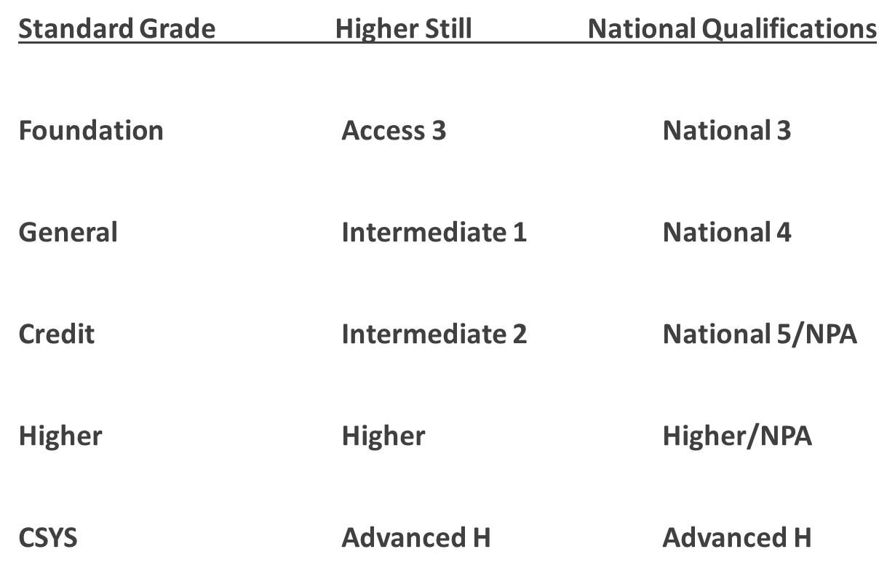
Levels and Progression:

Slide 7
The Senior Phase:
National Levels = 4 periods a week; S4 to S6 in classes.
National Progression Awards = 4 or 6 periods a week; all internal assessment/no exams.
Higher/Level 6 classes = 6 periods a week; S5 & S6 in classes.
Advanced Higher = up to 6 periods a week; S6 only.

Slide 8
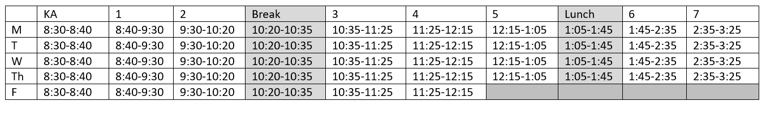
The New School day 2026-27

Slide 9
Wider Achievement
Wider Achievement options for S5 pupils picking Nationals e.g. Arts and Crafts; Touch Typing; Lab Skills; additional Maths/English; Mental Health Award; Film Studies; First Aid; Study Skills.

Slide 10
The Senior Phase:
Some s6 pupils: Timetabled Volunteering in junior classes & Buddying.
S4-6 - Potential for Work Experience – self-found placements.
Study – S6 only. For all, once a week; for some, in a Column.
J.E.T. available to S4/S5 LEAVERS – Summer and Winter cohorts.
College – applications open now!
Some courses available at other schools if not possible at Leith.

Slide 11
College Courses – Webpage:
https://www.edinburghcollege.ac.uk/courses/for-school-pupils

Slide 12

Courses for 2025-26 - examples:
Engineering Skills n5
Photography Higher
team Sports NPA
Sound Production & Recording NPA
Roofing/stonemasonry– S4/5 – PORTOBELLO
Introduction to College
Apply
Via
Edinburgh College Website or Handbook for FAs

Slide 13
Edinburgh College:
Foundation Apprenticeships:
Creative and Digital Media
Business skills
Food and Drink Technologies
HEALTH and SOCIAL CARE
Social Services: Children and Young People
scientific technologies
all growth areas for employment in Lothian;
all include work placements;
all 1-year courses.

Slide 14


Slide 15

Only for S5 Pupils – 2-year programme.
Social mobility focus.
Interest in developing employability skills.
Mentors/Mentee.
Masterclasses.
4-week paid internship summer of Year One – up to £1000.

Slide 16
Senior Phase Commitment
Attendance
Punctuality
iPads!! Charged and in every day
Holidays in Term Time – avoid if possible
Part-time Employment?
Study & Homework
Personal Development
Regular Hobbies/Interests?
S6 – Dropping Courses?

Slide 17

S4 & S5 – Thinking ahead
S6 – Acting soon – VET/MED DUE OCTOBER
Commitment to CfE – Standard Entry = Highers
Edinburgh/Glasgow – 4 or 3 As/rest Bs – easier entry if achieved in S5 exams; increased demands if over 2 years.
Open Days
Completing Courses – even if unconditional offers

Slide 18
S6 Prefects
Application via SLT – to follow
Commitment to Uniform
Commitment to Extracurricular Events
Commitment to representing the school – not just wearing the blazer!

Slide 19
E.M.A.
Parental/Carer Income for 2026-27 – Apply online:
https://www.edinburgh.gov.uk/support-pupils/apply-education-maintenance-allowance-ema
16 + years old
£30 per week
Every 2 weeks
In Arrears
1 Child in Household – up to £24,421; 2 or more Children in Household – up to £26,844 before tax
No payment if TBC for attendance.

Slide 20


Slide 21
DYW Live Opportunities: Apprenticeship and Jobs Event
MONDAY 9th March
Location: Edinburgh International Conference Centre (EICC), Morrison Street, Edinburgh
2-3pm for School Pupils – if pupils wish to attend then please let the school office know in advance

Slide 22
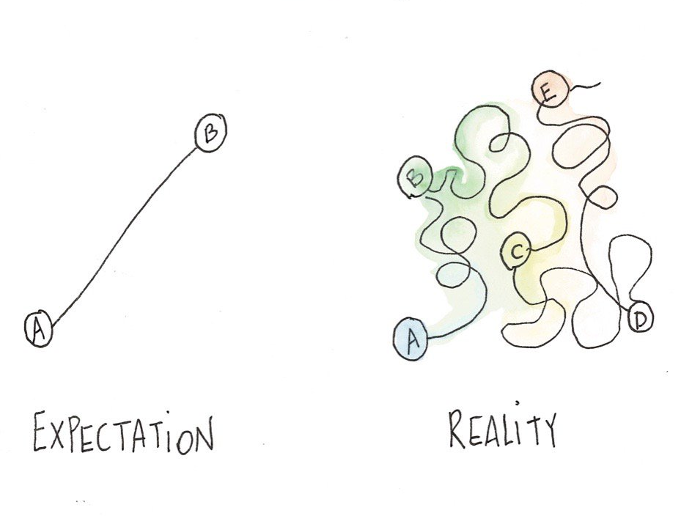
Career Advisor – Giles Macnair
Skills Development Scotland – Scotland’s national skills agency and careers service
School Careers Advisor – supporting students to develop career management skills and to put a plan in place so they know what their next step is
Career Management Skills – developing the skills and confidence to navigate your own unique career path

Slide 23

Pathways
Other Formal Training
Volunteering
Apprenticeships
University
Employment
College

Slide 24
Apprenticeships
3 types of apprenticeship:
  Foundation Apprenticeship
  Modern Apprenticeship
  Graduate Apprenticeship
Modern and Graduate Apprenticeships are a way to learn whilst in a job.
Notes:
With a Modern Apprenticeship, you learn on the job. You'll be just like any other employee, but you'll also be working towards a qualification.
You could be spending some time at work, and some time at college or with a training provider. But you'll be able to put your new skills into practice right away. And you're getting paid while you get your qualification.

Slide 25


Apprenticeship Example
Finishes school at the end of S4
with National 4s and 5s
Starts an Engineering
Modern Apprenticeship – work and college
Notes:
With a Modern Apprenticeship, you learn on the job. You'll be just like any other employee, but you'll also be working towards a qualification.
You could be spending some time at work, and some time at college or with a training provider. But you'll be able to put your new skills into practice right away. And you're getting paid while you get your qualification.

Slide 26

Apprenticeship Example
Finishes school at the end of S6
with a range of Highers and 1 Advanced Higher
Starts a Cyber Security
Graduate Apprenticeship – work and uni
Notes:
With a Modern Apprenticeship, you learn on the job. You'll be just like any other employee, but you'll also be working towards a qualification.
You could be spending some time at work, and some time at college or with a training provider. But you'll be able to put your new skills into practice right away. And you're getting paid while you get your qualification.

Slide 27

College
Focus on a specific area of interest (you can only apply for 1 full-time college course)
Progression through different levels e.g., Level 5 – NC (Level 6) – HNC (Level 7)
Full-time courses tend to be 3/4 days a week, allowing flexibility
A lot of the subjects are considered to be ‘vocational’ and can lead into employment or apprenticeships
Can help students transition from school
Can be a stepping stone to Higher Education (HNC/D)

Slide 28
Example College Pathways
Finishes school at the end of S5
with National 4s and National 5s
Completes an NC Level 6
course at college
Completes a HNC
at college
Starts university

Slide 29

Example College Pathways
Finishes school at the end of S6
with National 5s and 3 Highers
Completes a HNC
at college
Starts a
Graduate Apprenticeship

Slide 30
University
Most undergraduate degrees in Scotland are 4 years (these can be either Single or Joint Honours degrees)
Entry requirements vary between universities and courses
  However, most courses ask for 4+ Highers
  Some courses will specify ‘required subjects’
Most courses don’t ask for Advanced Highers and focus on Higher grades
  However, different universities (even departments within the same university) view Advanced Highers differently
LEAPS is a widening access programme that some students may be eligible for which allows them to receive an adjusted offer for their entry requirements

Slide 31


Careers Service
SDS offers free Careers Information, Advice, and Guidance to customers of all ages. You can either book an appointment via telephone.
To book an appointment, check out the website: Get in touch - Skills Development Scotland
To contact the school Careers Advisor, email: giles.macnair@sds.co.uk
www.myworldofwork.co.uk www.apprenticeships.scot

Slide 32
Learner Pathways
Requests or concerns to be passed onto Me – we will do our best…

